Slide 1
Number of Faces in Arrangements
Omar Shibli

Slide 2
Contents
Arrangements of Hyperplanes
Arrangements of Other Geometric Objects
Number of Vertices of Level at Most k
The Zone Theorem
The Cutting Lemma Revisited

Slide 3
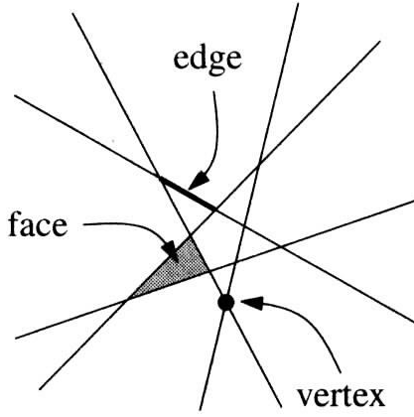
Arrangements of Hyperplanes
Recall from Section 4.1
For a finite set H of lines in the plane, the arrangement of H is a partition of the plane into relatively open convex subsets.
The faces of the arrangement
Vertices (0-faces).
Edges (1-faces).
Cells (2-faces)

Slide 4
Arrangements of Hyperplanes
Again, an arrangement of finite set H of hyperplanes in is a partition of it into relatively open convex faces.
Faces dimensions are 0 through d.
The 0-faces - Vertices.
The 1-faces - Edges.
The (d-1)-faces - Facets.
The d-faces - Cells

Slide 5
Arrangements of Hyperplanes
The cells are the connected
components of
To obtain the facets, we consider the (d-1)-dimensional arrangements induced in the hyperplanes of H by their intersections with the other hyperplanes.
That is, for each we take the connected
components of

Slide 6
Arrangements of Hyperplanes
To obtain k-faces, we consider every possible k-flat L defined as the intersection of some d-k hyperplanes of H. The k-faces of the arrangement lying within L are the connected components of
where ,

Slide 7
General Position
If a set H of hyperplanes is in general position, which means that the intersection of every k hyperplanes is (d-k)-dimensional, k = 2, 3,..., d+1,the arrangement of H is called simple.
For it suffices to require that every d hyperplanes intersect at a single point and no d+1 have a common point.
*

Slide 8
Counting the cells in a hyperplane arrangement
We want to count the maximum number of faces in a simple arrangement of n hyperplanes in .
Every d-tuple of hyperplanes in a simple arrangement determines exactly one vertex, and so a simple arrangement of n hyperplanes has exactly vertices.

Slide 9
The Plane
Number of vertices of
Vertices of H are intersections of
Number of edges of
Number of edges on a single line in H is one more than number of vertices on that line.
Number of cells of
Inductive reasoning: add lines one by one each
edge of new line splits a face.

Slide 10
Counting the cells in a hyperplane arrangement
Proposition:
The number of cells (d-faces) in a simple arrangement of n hyperplanes in equals
Note: Steiner (1826) had earlier derived this formula for d≤3. Buck (1943) extended the formula to the total number of k-dimensional 'cells' formed (k = 0, ..., d).

Slide 11
First proof.
We proceed by induction on both the dimension d and the number of hyperplanes n, assume both {d-1, n-1} and {d, n-1} are true.
Now suppose that we are in dimension d, we have n-1 hyperplanes, and we insert another one. The n-1 previous hyperplanes divide the newly inserted hyperplane h into cells by the inductive hypothesis.
Each such (d-1)-dimensional cell within h partitions one d-dimensional cell into exactly two new cells. The total increase in the number of cells caused by inserting h is thus , and
so

Slide 12
First proof.
So it remains to check that formula satisfies the recurrence. We have

Slide 13
Second proof.
We proceed by induction on d, the case d = 0 being trivial. Let H be a set of n hyperplanes in R^{d} in general position; in particular, we assume that no hyperplane of H is horizontal and no two vertices of the arrangement have the same vertical level
Let g be an auxiliary horizontal hyperplane lying below all the vertices. A cell of the arrangement of H either is bounded from below, and in this case it has a unique lowest vertex, or is not bounded from below, and then it intersects g.
The number of cells of the former type is the same as
the number of vertices, which is . The cells of the
latter type correspond to the cells in the (d-1)-dimensional arrangement induced within g by the
hyperplanes of H, and their number is thus .

Slide 14
What the number of faces of dimensions 1 and 2 for a simple arrangement of n planes in ?

Slide 15
Sign Vectors
A face of the arrangement of H can be described by its sign vector.
First we need to fix the orientation of each hyperplane.
Each h partitions into three regions.
h itself.
Two open half-spaces , We choose one of these as positive and denote it by , and we let the other one be negative, denoted by .

Slide 16
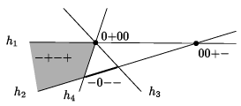
Sign Vectors
Let F be a face of the arrangement of H. We define the sign vector of F (with respect to the chosen orientations of the hyperplanes) as , where
Of course, not all possible sign vectors correspond to nonempty
faces. For n lines, there are 3^{n} sign vectors but only O(n²) faces.

Slide 17
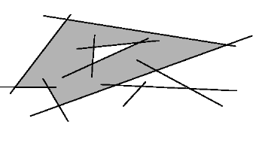
Arrangements of Other Geometric Objects
For arbitrary sets . The arrangement is a subdivision of space into connected pieces again called the faces. Each face is an inclusion-maximal connected set that "crosses no boundary."
Definition:
equivalence relation ≈ on R^{d}:
We put x ≈ у whenever x and у lie in the same subcollection of the A_{i},

Slide 18
Arrangements of Algebraic Surfaces
Let be polynomials with real coefficients in d variables, and let be the zero set of p_{i}. Let D denote the maximum of the degrees of the p_{i}.
When speaking of the arrangement of Z₁, Z₂, …, Z_{n}, one usually assumes that D is bounded by some (small) constant.

Slide 19
Arrangements of Algebraic Surfaces
In many cases, the Z_{i} are algebraic surfaces, such as ellipsoids, paraboloids, etc., but since we are in the real domain, sometimes they need not look like surfaces at all.
It is known that if both d and D are considered as constants, the maximum number of faces in the arrangement of Z₁, Z₂, …, Z_{n} as above is at most O(n^{d}).

Slide 20
Sign Patterns
A vector is called a sign pattern of p₁, p₂, …, p_{n} if there exists an such that the sign of p_{i}(x) is , for all i = 1,2,...,n.
there are at most sign patterns in dimension d. This result is generally called the Milnor-Thom theorem.

Slide 21
Theorem: Number of Sign Patterns
Let p₁, p₂, …, p_{n} be d-variate real polynomials of degree at most D. The number of faces in the arrangement of their zero sets
, and consequently the number of sign patterns of p₁, p₂, …, p_{n} as well
is at most
For n ≥d≥2, this expression is bounded
by

Slide 22
Arrangements of Pseudolines
An arrangement of pseudolines is a natural generalization of an arrangement of lines. Lines are replaced by curves, but we insist that these curves behave, in a suitable sense, like lines: For example, no two of them intersect more than once.

Slide 23
Arrangements of Pseudolines
An (affine) arrangement of pseudolines can be defined as the arrangement of a finite collection of curves in the plane that satisfy the following conditions:
Each curve is x-monotone and unbounded in both directions; in other words, it intersects each vertical line in exactly one point.
Every two of the curves intersect in exactly one point and they cross at the intersection.

Slide 24
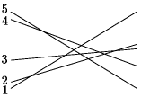
Arrangements of Pseudolines
Wiring diagram
Realization by straight lines

Slide 25
Arrangements of Pseudolines
equivalence of two arrangements of pseudolines.
Let H be a collection of n pseudolines. We number the pseudolines 1, 2,..., n in the order in which they appear on the left of the arrangement, say from the bottom to the top. For each i, we write down the numbers of the other pseudolines in the order they are encountered along the pseudoline i from left to right.

Slide 26
Arrangements of Pseudolines
We call two arrangements affinely isomorphic if they yield the same π₁, π₂, …, π_{n}

Slide 27
Stretchability
An arrangement of pseudolines is stretchable if it is affinely isomorphic to an arrangement of straight lines.
It turns out that all arrangements of 8 or fewer pseudolines are stretchable, but there exists a nonstretchable arrangement of 9 pseudolines.

Slide 28
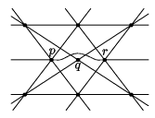
Nonstretchability
Proof:
Based on the Pappus theorem in projective geometry, which states that if 8 straight lines intersect as in the drawing, then the points p, q, and r are collinear.
Pappus

Slide 29
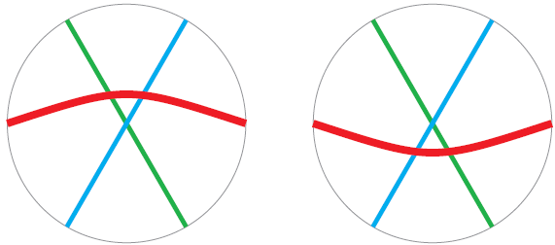
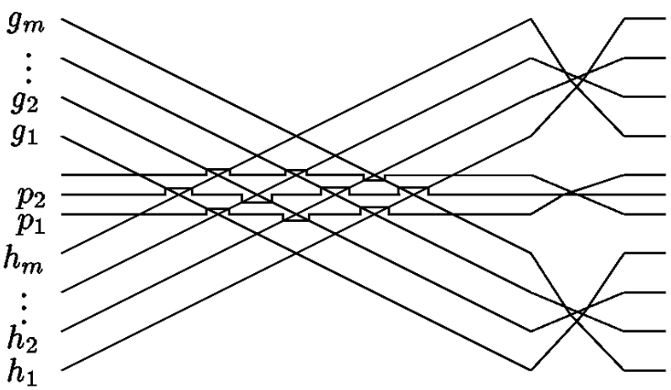
Nonstretchability
The following construction shows that the number of isomorphism classes of simple arrangements of n pseudolines is at least .

Slide 30
Estimate The Number of Nonisomorphic
Let the lines be l₁, l₂, …, l_{n} where l_{i} has the equation у = a_{i} х + b_{i} and a₁>a₂>…>a_{n} .
The x-coordinate of the intersection l_{i} ∩ l_{j} is
To determine the ordering π_{i} of the intersections along l_{i}, it suffices to know the ordering of the x-coordinates of these intersections.

Slide 31
This can be inferred from the signs of the polynomials:
So the number of nonisomorphic arrangements of n lines is no larger than the number of possible sign patterns of the O(n³) polynomials p_{ijk} in the 2n variables a₁, b₁, a₂, b_{2,} …, a_{n}, b_{n}, and it yields the upper
bound of .

Slide 32
Stretchability is NP-Hard
The problem of deciding the stretchability of a given pseudoline arrangement has been shown to be algorithmically difficult (at least NP-hard).

Slide 33
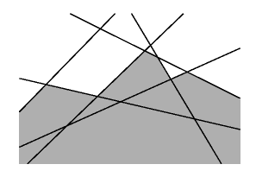
Number of Vertices of Level at Most K
We are interested in the maximum possible number of vertices of level at most K in a simple arrangement of n hyperplanes.

Slide 34
Asymptotic Upper Bound Theorem
The vertices of level 0 are the vertices of the cell lying below all the hyperplanes, and since this cell is the intersection of at most n half-spaces, it has at most vertices, by the asymptotic upper bound theorem (Theorem 5.5.2).

Slide 35
Clarkson's Theorem on Levels
The total number of vertices of level at most k in an arrangement of n hyperplanes in R^{d} is at most:

Slide 36
Motivation
Given an n-point set P ⊂ R^{d} ,
we want to construct a data structure for fast answering of queries of the following type:
For a query point x ∈ R^{d} and an integer t, report the t points of P that lie nearest to x.

Slide 37
The Plane
Let H be a set of n lines in general position
Let p denote a certain suitable number, 0<p<1 .
choose a subset R ⊆ H at random,
including each line h into R with probability p.
Let us consider the arrangement of R.
Let f(R) denote the number of vertices of level 0 .

Slide 38
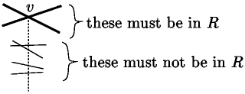
We estimate the expectation of f, denoted by E[f], in two ways.
f(R) < |R| for any specific set R, and hence E[f] < Е[|R|] = pn.
Define an event A_{v} if v becomes one of the vertices of level 0 in the arrangement of R.
Prob[A_{v}]= p²(1-p)^{l(v)}

Slide 39
Let V be the set of all vertices of the arrangement of H.
Altogether ,
and so

Slide 40
Proof for an arbitrary dimension.
we define an integer parameter r and choose a random r-element subset R ⊆ Н,
with all subsets being equally probable.
f(R) = for all R, and so .
we denote this by P(l) .

Slide 41
Combining with , we obtain
An appropriate value for the parameter r is
Lemma. Suppose that , which implies . Then P(K) ≥ c_{d}(k+1)^{-d} .
for k > n/2d, then the bound claimed by the theorem is of order n^{d}.
for k = 0 we already know that the theorem holds.
So we may assume , and we have

Slide 42
Proof of Lemma:

Slide 43
Now,
-
-
And we arrive at

Slide 44
Thank You

