Slide 1
Data Structures
Lecture 2
Amortized Analysis
“amortized analysis finds the average running time per operation over a worst-case sequence of operations.”
Haim Kaplan and Uri Zwick February 2010

Slide 2
A ferry tale
Cost of moving ferry = C
Cost for first 7 passengers = 0
Cost for 8-th passenger = C
Average/amortized cost for each passenger = C/8

Slide 3
A ferry tale (Chapter 2)
Suppose C=8
amort(IN) = 1 amort(OUT) = 1
amort(IN) = 2 amort(OUT) = 0
amort(IN) = 3 amort(OUT) = −1
Assuming the island is initially empty

Slide 4
Implementing lists using (circular) arrays with resizing
n=M
L
array
a₀
a₁
…
a_{M−1}
maxlen
M
length
M
M
What do we do when the array is full?
We cannot extend the array
Allocate a larger array and copy
What should be the size of the new array?

Slide 5
Implementing lists using (circular) arrays with resizing
n=M
L
array
a₀
a₁
…
a_{M−1}
maxlen
M
length
M
M
If we start with an empty array and increase its length by 1, then the time to do n Insert-Last is about:
Average/amortized time per operation = O(n)

Slide 6
Implementing lists using (circular) arrays with doubling
When the array is full, double its size and copy
What is the cost of n Insert-Last operations?
Assume, for simplicity that n=2^{k}
cost of insertion
cost of copying
The average/amortized cost of each operation is O(1)

Slide 7
Implementing lists using (circular) arrays with doubling
When the array is full, double its size and copy
n=2^{k} seems to be ‘fortunate’ case.
What if n=2^{k}+1 ? Last operation causes copying.
cost of insertion
cost of copying
The amortized cost of each operation is still O(1)

Slide 8
Worst-case bounds
Suppose that a data structure supports k different types of operations T₁, T₂,…,T_{k}
Let worst(T_{i}), the maximal time that a single operation of type T_{i} may take.
Let op₁, op₂,… op_{n} be a sequence of operations that includes n_{i} operations of type T_{i}.
Sometimes, this bound is very loose.

Slide 9
Amortized bounds
We say that amort(T_{i}) is an amortized bound on the cost of an operation of type T_{i} iff
for every valid sequence of operations op₁, op₂,… op_{n} that includes n_{i} operations of type T_{i} we have
Note: Amortized bounds are bounds, they are not unique

Slide 10
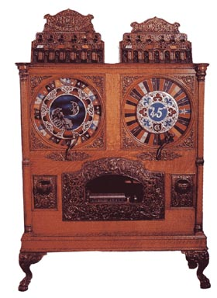
Coin operated computer
A token pays for a constant number of operations
Each operation may buy tokens and
Use them immediately
Leave tokens for subsequent operations
Use tokens left by previous operations
Number of tokens bought is clearly an upper bound on the number of operations performed

Slide 11
The Accounting method
Saving for a rainy day - “Keep something, esp. money, for a time in the future when it might be needed”
Each “normal” insert operations buys three tokens.
It uses one of them to insert the new item.
It leaves the other two in the “bank”
When the array is full, the bank contains enough tokens to pay for the copying!
What about the cost of allocating the new array?

Slide 12
The Accounting method
Theorem: If the array contains M/2+k items, where k≥0, then the bank contains at least 2k tokens.
Easy proof by induction
Corollary: When the array is full, the bank contains enough tokens to pay for copying all the items into a new array
Amortized cost of an operation ≡ number of tokens bought by the operation
Note: Tokens are only used in the analysis!
The data structure doesn’t really manipulate them.

Slide 13
Implementing lists using arrays with resizing
n
L
array
a₀
a₁
…
a_{M−1}
maxlen
M
length
n
M
amort(Insert-Last) = 3
amort(Delete-Last) = 1
amort(Insert(i)) = n−i+3
amort(Retrieve(i)) = 1

Slide 14
The Potential method
Very similar to the accounting method
The difference:
Instead of specifying in advance how many tokens each operation should buy,
specify how many tokens should be in the bank in each state of the data structure
Potential ≡ Φ ≡ Balance of bank account

Slide 15
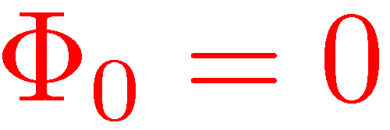
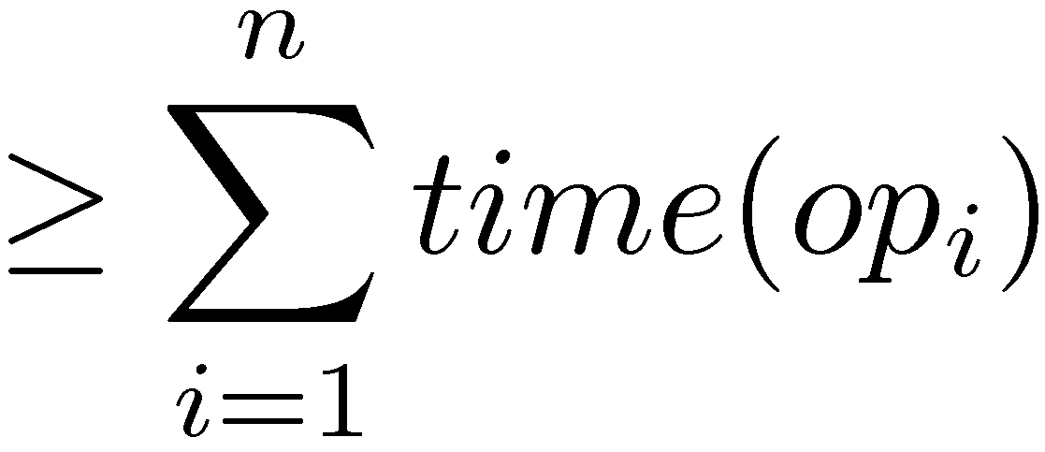
The Potential method
Bank account initially empty
≥ 0
No overdraft!

Slide 16
Potentials for expanding arrays
When array is not full
1
≤ 2
When array is full
M+1
2−M
At most 3 in both cases!

Slide 17
Potentials for expanding arrays
1
≤ 0
1
0
The amortized cost of Delete-Last is sometimes negative. When?

Slide 18
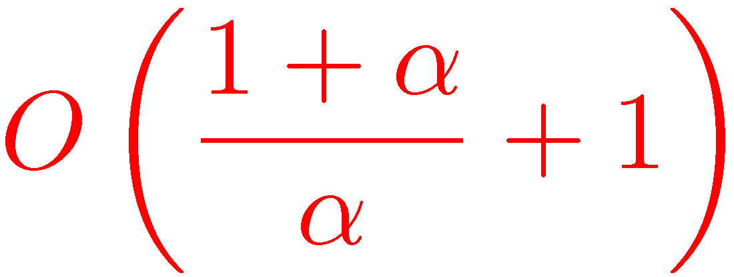
Not only doubling Trade-offs between time and space
Suppose that instead of doubling, we multiply the size of the array by 1+α, where α>0
Amortized cost of Insert-Last is
Find an appropriate potential function

Slide 19
Expanding and shrinking arrays
What do we do when a very large array contains very few elements?
When n=M, double the size
When n=M/2, half the size ?
Both worst-case and amortized costs are O(n)

Slide 20
Expanding and shrinking arrays
What do we do when a very large array contain very few elements?
When n=M, double the size
When n=M/4, half the size !
Amortized cost now O(1)
Which potential function should we use?

Slide 21
Expanding and shrinking arrays (Dynamic arrays)
We always have M/4 < n < M

Slide 22
Lazy deletions from singly linked lists
L
a₀
a₁
…
a_{n-1}
Delete(A) simply sets A.item to null
Retrieve-Node(L,i) deletes empty nodes while scanning for the i-th item
worst(Insert-After) = O(1)
worst(Delete) = O(1)
worst(Retrieve-Node(i)) = unbounded

Slide 23
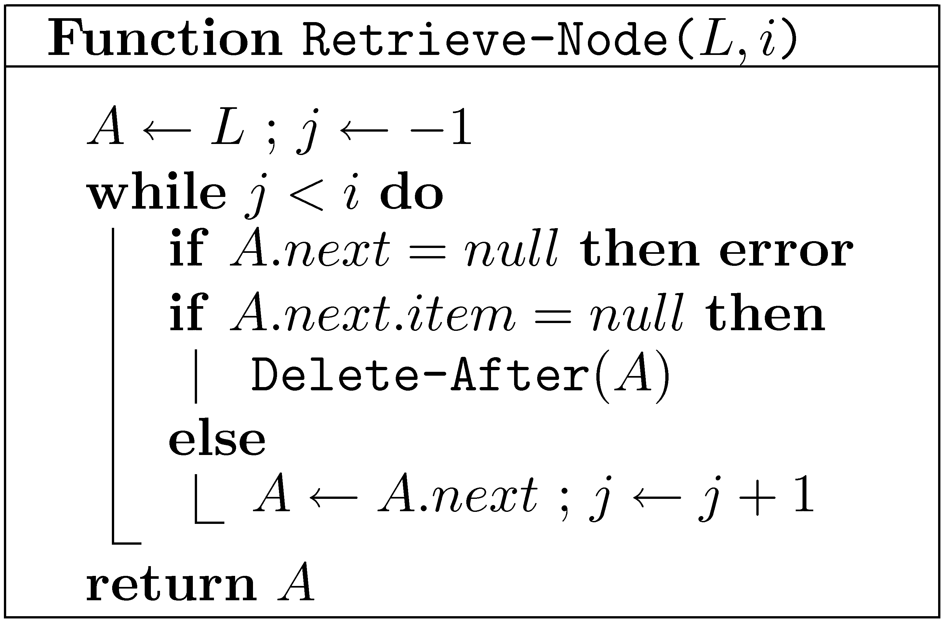
Lazy deletions from singly linked lists
L
a₀
a₁
…
a_{n-1}
amort(Insert-After) = O(1)
amort(Delete) = O(1)
amort(Retrieve-Node(i)) = O(i+1)
Φ ≡ Number of deleted items

Slide 24
De-Amortization
In some cases, but not all, amortized bounds can be converted into worst-case bounds
For example, in dynamic arrays, instead of leaving two tokens for future operations, we can actually move two elements
Can we do something similar with lazy singly linked lists?

Slide 25
De-Amortized dynamic arrays
L.small
L.medium
L.large
L.medium is always up to date
If L.medium is full then L.large is up to date
If L.medium is ¼ full then L.small is up to date
Updates may need to be performed on all three lists

Slide 26
Amortized vs. Worst-case
Amortization gives worst-case bounds for a whole sequence of operations
In many cases, this is what we really care about
In some cases, such as real-time applications, we need each individual operation to be fast
In such cases, amortization is not good enough

