Slide 1
Data Structures
Lectures: Haim Kaplan and Uri Zwick
Teaching Assistant: Yahav Nussbaum
Website:
http://ds10.wikidot.com/
Exam: 80%
Theoretical Assingnments: 10%
Practical Assignments: 10%
Cormen, Leiserson, Rivest and Stein Introduction to Algorithms (Second Edition)

Slide 2
Data Structures
“In computer science, a data structure is a particular way of storing and organizing data in a computer so that it can be used efficiently.”
Lists
Search Trees
Heaps/Priority Queues
Sorting and Selection
Hashing
Union-Find
Tries and Suffix Trees

Slide 3
Data Structures
Lecture 1
Abstract Data Types
Lists, Stacks, Queues, Deques Arrays, Linked Lists
Amortized Analysis
Haim Kaplan and Uri Zwick February 2010

Slide 4
Lists (Sequences)
b
[a₀ a₁ a₂ a₃ … a_{i-1} a_{i} a_{i+1} … a_{n-2} a_{n-1} ]
Insert b at position i :
Delete the item at position i:
Retrieve the item at position i:

Slide 5
Abstract Data Type (ADT) Lists (Sequences)
List() – Create an empty list Length(L) – Return the length of list L
Insert(L,i,b) – Insert b as the i-th item of L Retrieve(L,i) – Return the i-th item of L Delete(L,i) – Delete and return the i-th item of L
( Search(L,b) – Return the position of b in L, or −1 )
Interesting special cases:
Insert-First(L,b), Retrieve-First(L), Delete-First(L) Insert-Last(L,b), Retrieve-Last(L), Delete-Last(L)

Slide 6
Abstract Data Types (ADT) Stacks, Queues, Dequeues
Stacks – Implement only: Insert-Last(L,b), Retrieve-Last(L), Delete-Last(L) Also known as: Push(L,b), Top(L), Pop(L) Last In First Out (LIFO)
Queues – Implement only: Insert-Last(L,b), Retrieve-First(L), Delete-First(L) First In First Out (FIFO)
Deques (double ended queues) – Implement only: Insert-First(L,b), Retrieve-First(L), Delete-First(L) Insert-Last(L,b), Retrieve-Last(L), Delete-Last(L)

Slide 7
Implementing lists using arrays
We need to know the maximal length M in advance.
n
L
array
a₀
a₁
…
a_{n−1}
maxlen
M
*
*
*
length
n
M
Retrieve(L,i) (of any element) takes O(1) time
Insert-Last(L,b) and Delete-Last(L) take O(1) time
Stack operations in O(1) time

Slide 8
Implementing lists using arrays
We need to know the maximal length M in advance.
n
L
array
a₀
a₁
…
a_{n−1}
maxlen
M
*
*
*
length
n
M
Retrieve(L,i) (of any element) takes O(1) time
Insert-Last(L,b) and Delete-Last(L) take O(1) time
Insert(L,i,b) and Delete(L,i) take O(n−i+1) time

Slide 9
Implementing lists using arrays
L
0
1
n
n−1
array
maxlen
M
length
n
n+1
M
Delete-Last very similar

Slide 10
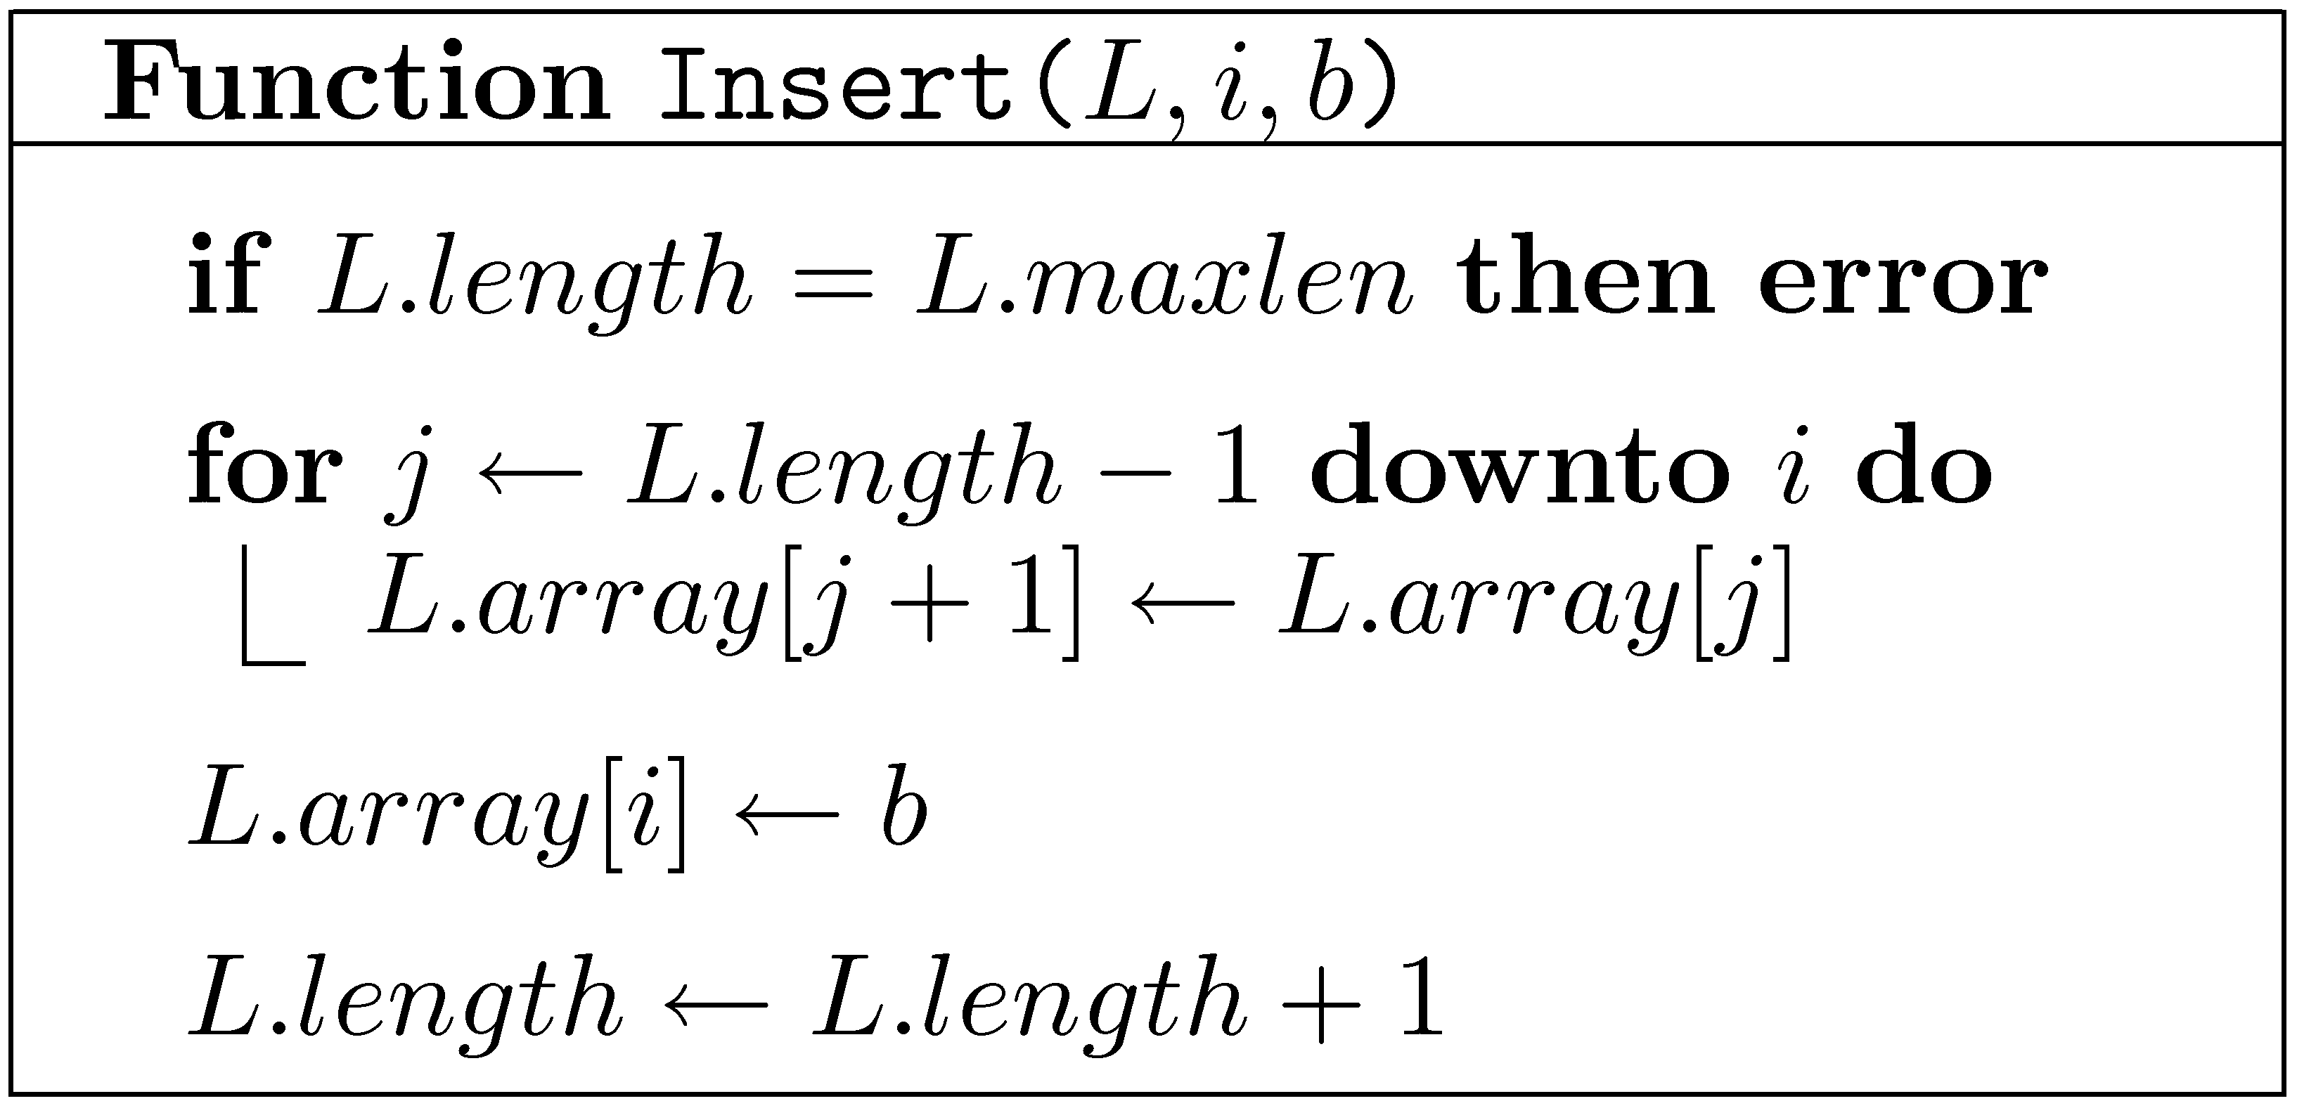
Implementing lists using arrays
L
0
1
i
n
n−1
array
maxlen
M
length
n
n+1
M
We need to move n−i items, then insert. O(n−i+1) time.

Slide 11
Implementing lists using circular arrays
Implement queue and deque operations in constant time
n
L
0
1
2
array
maxlen
M
length
n
start
2
M
New field: start

Slide 12
Implementing lists using circular arrays
Implement queue and deque operations in constant time
L
0
1
2
M−4
M−1
array
maxlen
M
length
7
start
M−4
M
Occupied region can wrap around!

Slide 13
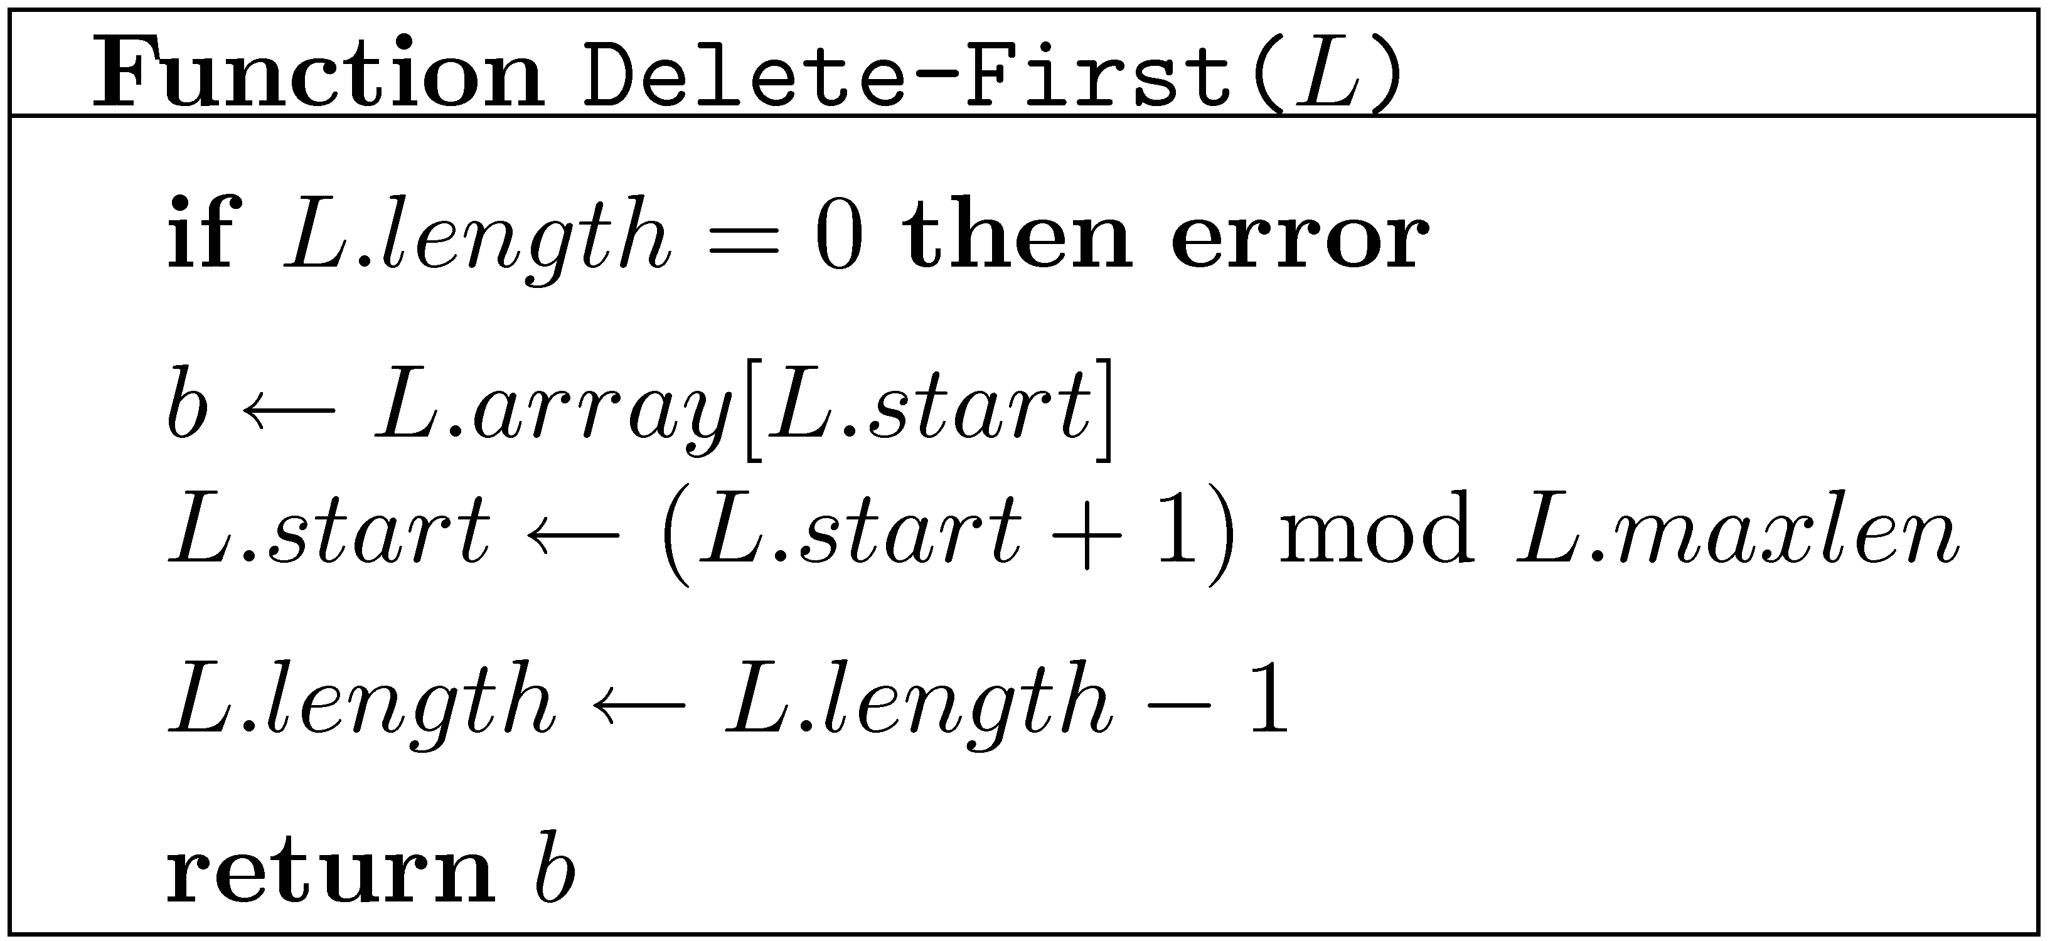
Implementing lists using circular arrays
Implement queue and deque operations in constant time
n
L
0
1
n−1
array
maxlen
M
length
n−1
n
start
1
M
0
Code of other operations similar

Slide 14
Implementing lists using singly linked lists
Lists of unbounded length Support some additional operations
L
List object
first
last
length
n
item
next
a₀
a₁
a₂
…
a_{n-1}
List-Node object

Slide 15
Insert-First with singly linked lists
Insert-First(L,b)
L
Generate a new List-Node object B containing b
first
Add B to the list
last
n+1
Adjust L.last, if necessary
length
n
B
Increment L.length
(Return B)
b
item
next
…
a₀
a₁
a₂
…
a_{n-1}

Slide 16
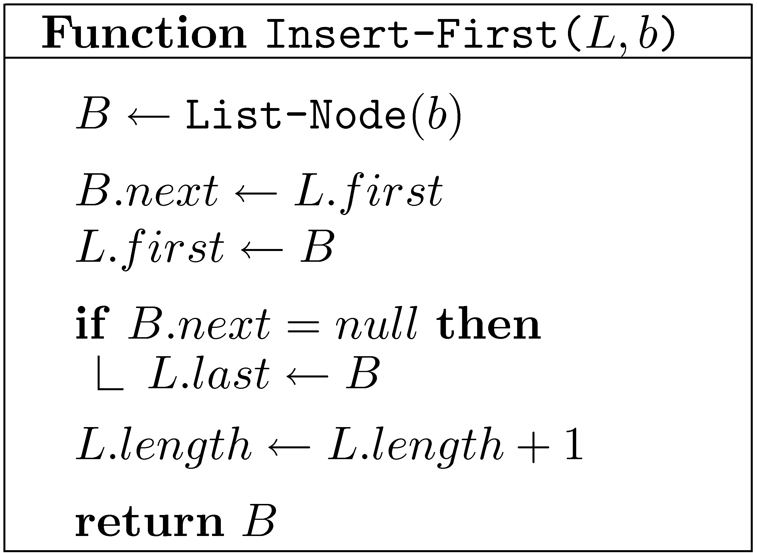
Insert-First with singly linked lists
L
first
last
n+1
length
n
B
b
item
next
…
a₀
a₁
a₂
…
a_{n-1}
Insert-Last and Delete-First– very similar, also O(1) time
Unfortunately, Delete-Last requires O(n+1) time

Slide 17
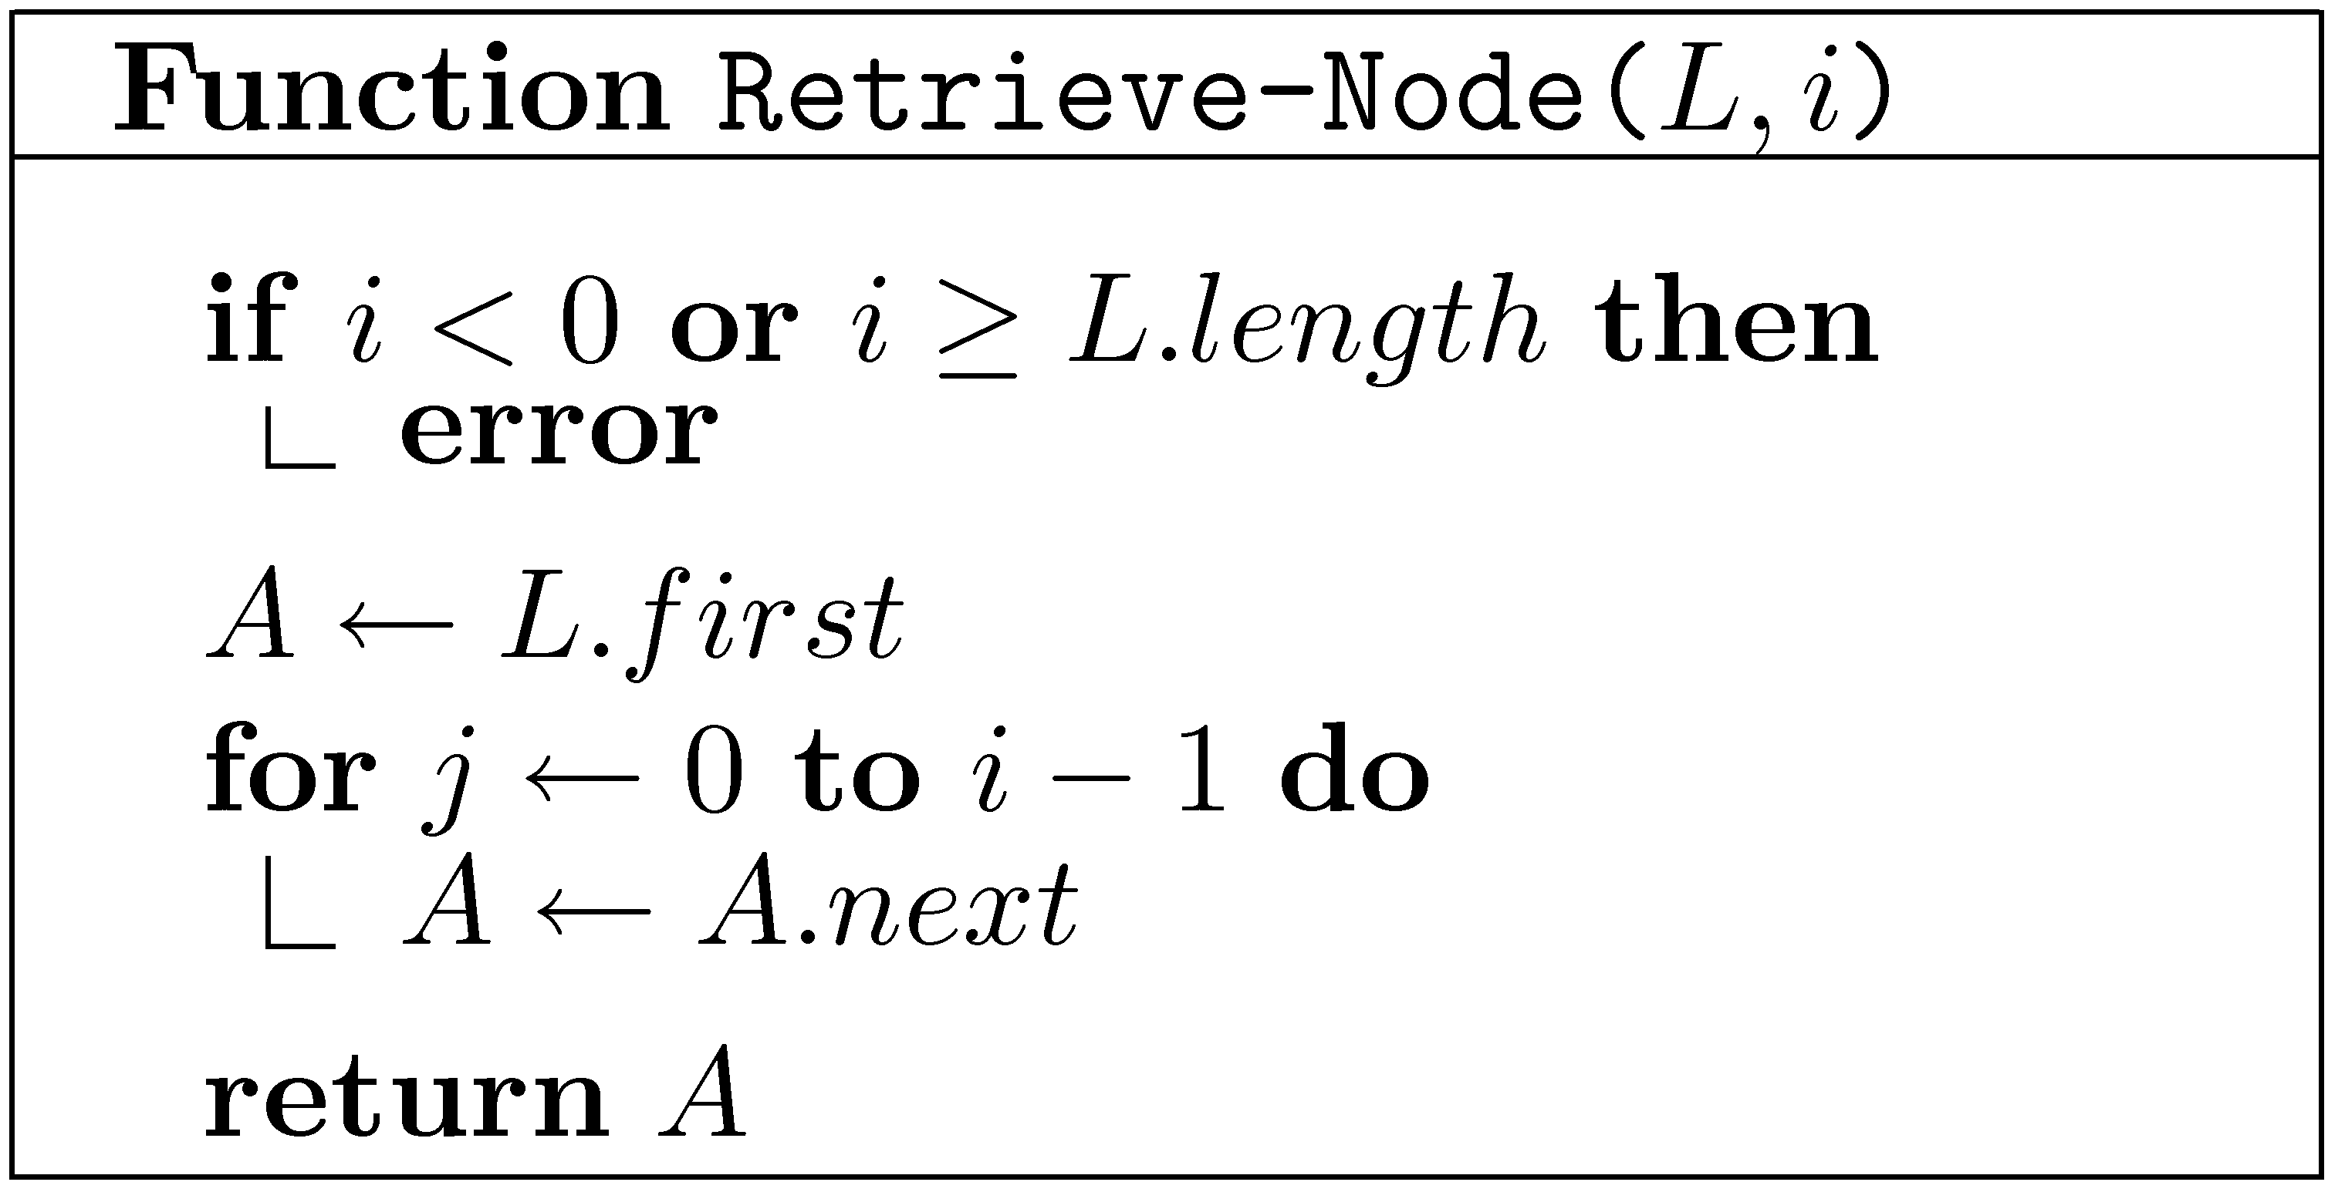
Retrieve with singly linked lists
L
first
last
length
n
item
next
a₀
a₁
a₂
…
a_{n-1}
Retrieving the i-th item takes O(i+1) time

Slide 18
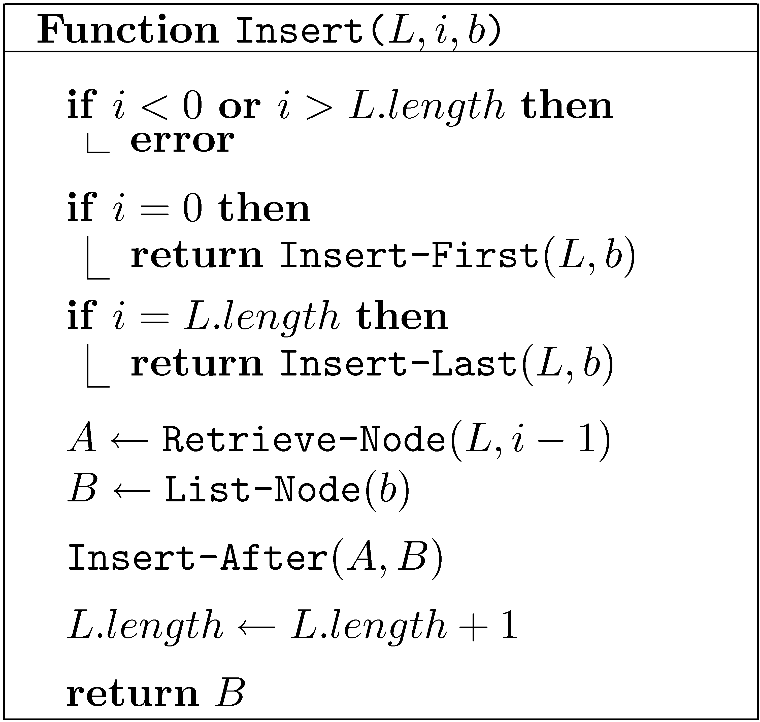
Insert with singly linked lists
L
first
last
length
n
item
next
a₀
a₁
a₂
…
a_{n-1}
Inserting an item into position i takes O(i+1) time

Slide 19
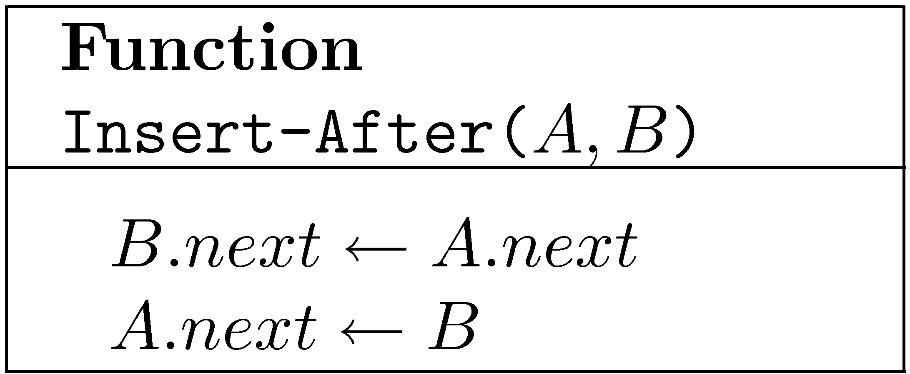
Inserting a node (After a given node)
Insert-After(A,B) – Insert B after A
A
…
a_{i−1}
a_{i}
…
B
b

Slide 20
Deleting a node (After a given node, not the last one)
Delete-After(A) – Delete the node following A
A
…
a_{i−1}
a_{i}
…
a_{i+1}
What happens to the node removed?

Slide 21
Abstraction barriers
User
List Insert, Retrieve, Delete
Search
ListNode Retrieve-Node Insert-After, Delete-After

Slide 22
Circular arrays vs. Linked Lists
 | Circular arrays | Linked lists
Insert/Delete-First Delete-First | O(1) | O(1)
Delete-Last | O(1) | O(n)
Insert/Delete(i) | O(min{i+1,n−i+1}) | O(i+1)
Retrieve(i) | O(1) | O(i+1)
Arrays always better than lists?
Arrays have a fixed size. (For the time being.)
Linked lists can do a few more things.

Slide 23
Concatenating lists
Concat(L₁,L₂) – Attach L₂ to the end of L₁
L₁
n
…
n+m
a_{n-1}
a₀
a₁
a₂
L₂
m
…
b_{m-1}
b₀
b₁
b₂
O(1) time!
(What happened to L₂?)

Slide 24
Circular arrays vs. Linked Lists
 | Circular arrays | Linked lists
Insert/Delete-First Insert-Last | O(1) | O(1)
Delete-Last | O(1) | O(n)
Insert/Delete(i) | O(min{i+1,n−i+1}) | O(i+1)
Retrieve(i) | O(1) | O(i+1)
Concat | O(min{n₁,n₂}+1) | O(1)
Linked list can do still more things…

Slide 25
Modified ADT for lists
The current specification does not allow us to utilize one of the main capabilities of linked lists:
Insert-After, Delete-After, Next in O(1) time
We can define a new ADT in which the user is allowed to call ListNode, Insert-After, Delete-After.

Slide 26
Lists with “handles”
A
B
[a₀ a₁ a₂ a₃ … a_{i-1} a_{i} a_{i+1} … a_{n-2} a_{n-1} ]
Insert operations return a handle to the item inserted
Items can be accessed and moved through their handles

Slide 27
Lists with “handles”
A
B
[a₀ a₁ a₂ a₃ … a_{i-1} a_{i} a_{i+1} … a_{n-2} a_{n-1} ]
List() – Create an empty list Length(L) – Return the length of list L
Insert(L,i,b) – Insert b as the i-th item of L Retrieve(L,i) – Return the i-th item of L Delete(L,i) – Delete and return the i-th item of L
Concat(L₁, L₂) – Concatenate L₁ and L₂

Slide 28
Lists with “handles”
A
B
[a₀ a₁ a₂ a₃ … a_{i-1} a_{i} a_{i+1} … a_{n-2} a_{n-1} ]
Insert(L,i,b) – Insert b as the i-th item of L Retrieve(L,i) – Return the i-th item of L Delete(L,i) – Delete and return the i-th item of L
List() – Create an empty list Length(L) – Return the length of list L
Concat(L₁, L₂) – Concatenate L₁ and L₂
Handle(b) – Return a handle to item b
Next(A) – Return a handle to item following A (assuming there is one)
Insert-After(A,B) – Insert B after A (assuming B is not in any list)
Delete-After(A) – Delete the item following A (assuming there is one)
Note: L is not an argument of these operations!

Slide 29
Implementing Lists with “handles” using Linked Lists
A
B
[a₀ a₁ a₂ a₃ … a_{i-1} a_{i} a_{i+1} … a_{n-2} a_{n-1} ]
Handles List-Nodes
Operations involving handles take O(1) time
How do we maintain the length of a list?
How do we keep track of first and last elements of a list?

Slide 30
Delete vs. Delete-After
A
B
[a₀ a₁ a₂ a₃ … a_{i-1} a_{i} a_{i+1} … a_{n-2} a_{n-1} ]
We have
Delete-After(A) – Delete the item following A
How about
Delete(A) – Delete item with handle A
We cannot delete A from a singly linked list without a handle to the item preceding it.

Slide 31
Implementing lists using doubly linked lists
Insert and deleting nodes in O(1) time
Concatenation also in O(1) time
L
Each node now has a prev field
first
last
length
n
prev
item
next
a₀
a₁
a₂
…
a_{n-1}
First and last element are special. Causes problems.
Difficult to maintain length when nodes inserted and deleted

Slide 32
Deleting a node from a Doubly Linked List
Each node now has a prev field
Delete(A) – Delete node A from its list
A
a_{i−1}
a_{i}
a_{i+1}
…
Note: A itself not changed! Is that good?

Slide 33
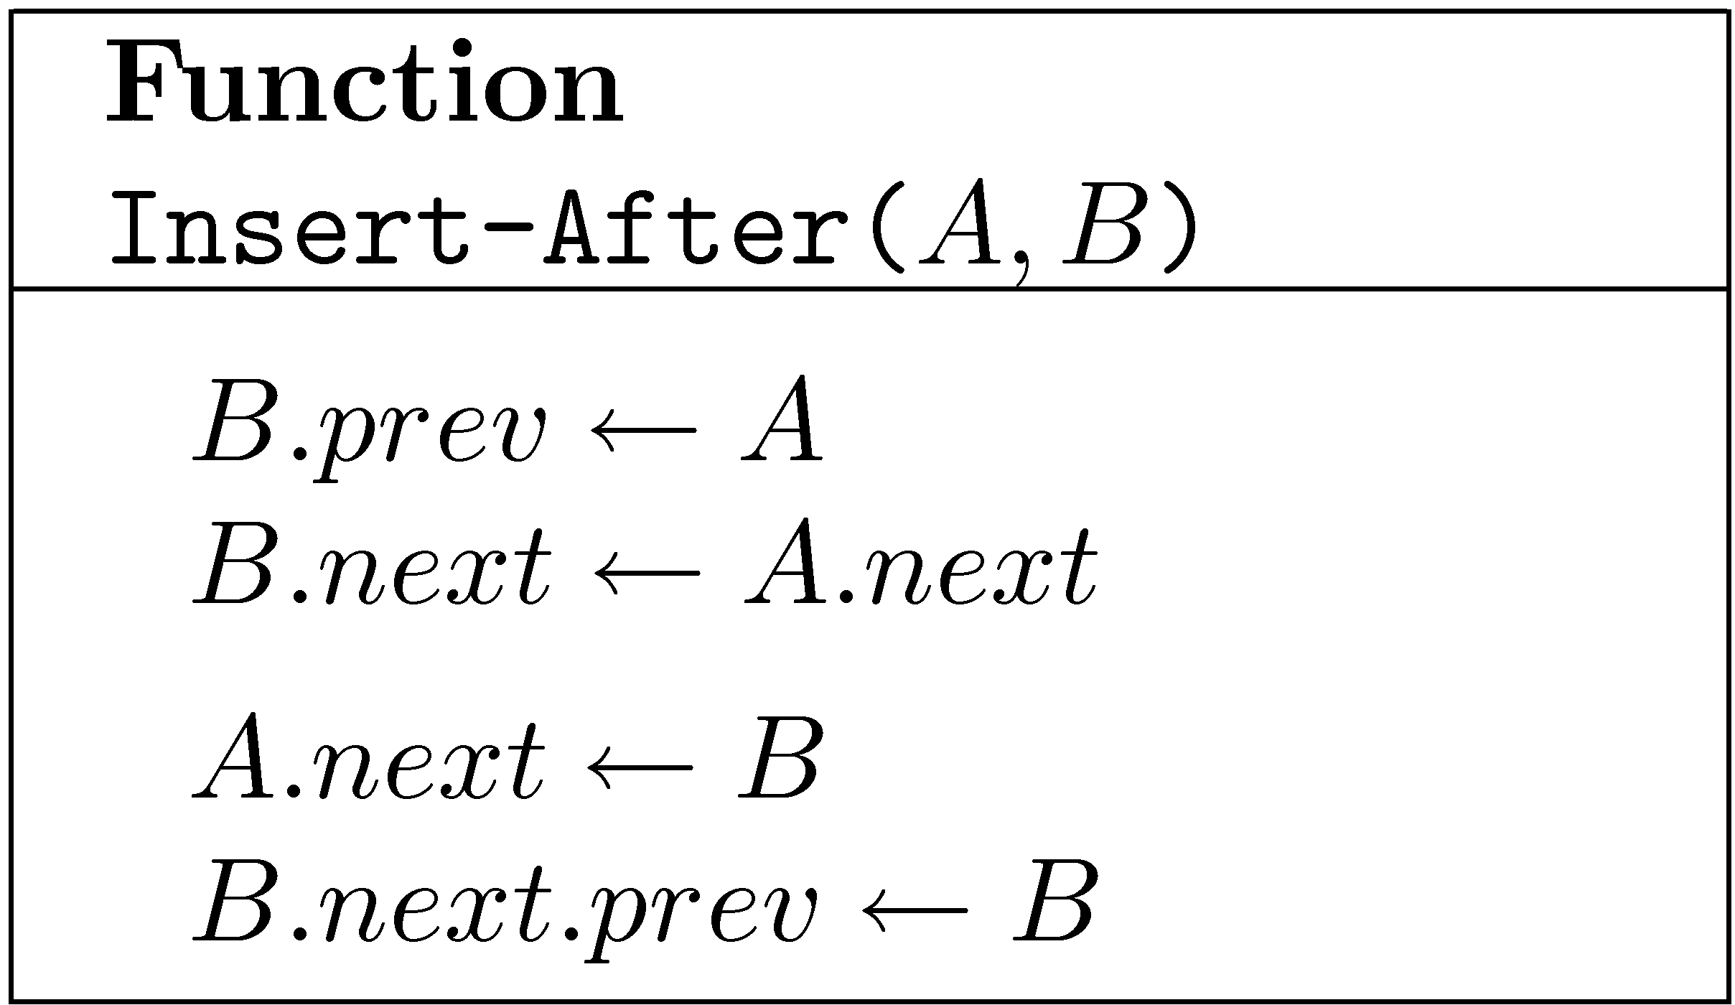
Inserting a node into a Doubly Linked List
Insert-After(A,B) – Insert node B after node A
A
a_{i}
a_{i−1}
b
B

Slide 34
Implementing lists with handles using circular doubly linked lists
The list is now circular
L
A sentinel is added
first
a₁
a₂
a₃
…
a_{n-1}
Each node has a successor and a predecessor
No special treatment of first and last element
Every node can be removed in O(1) time

Slide 35
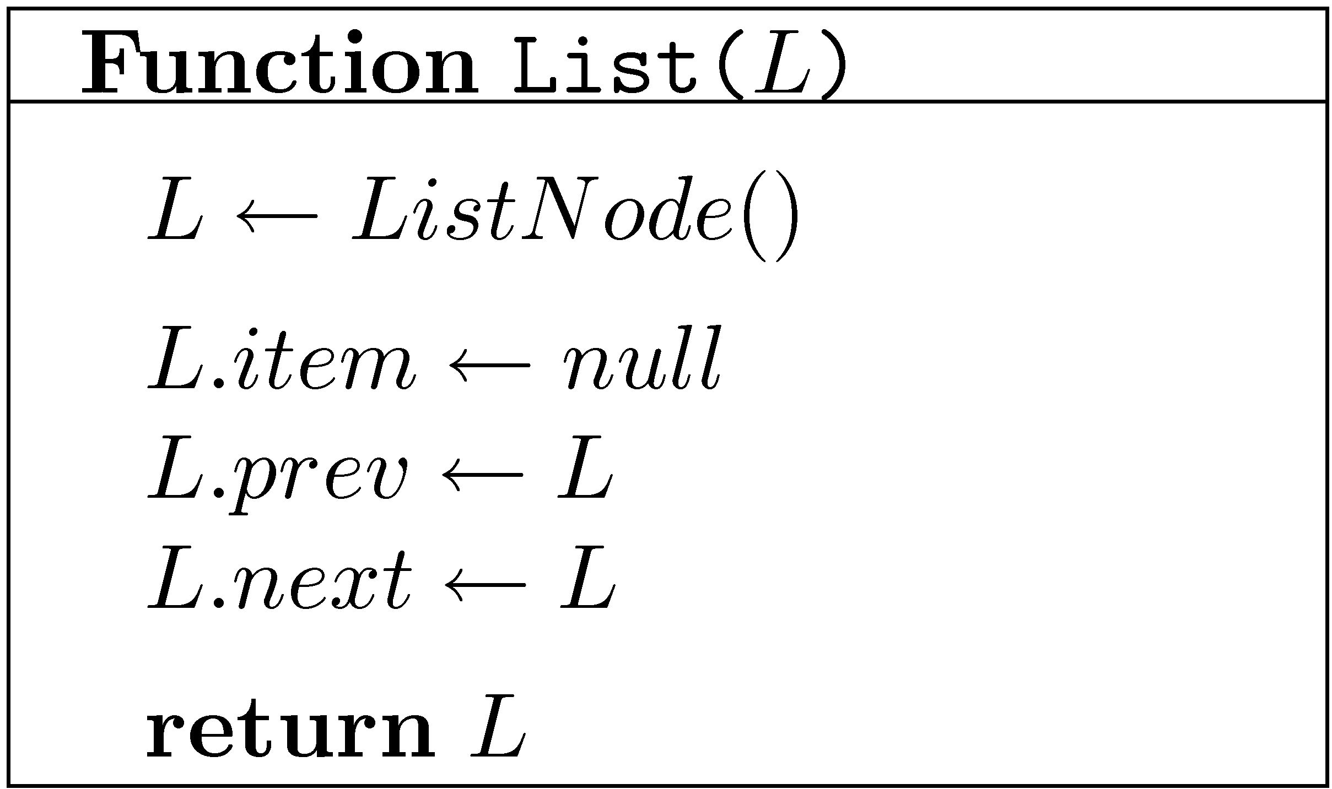
Implementing lists with handles using circular doubly linked lists
L
Empty list

Slide 36
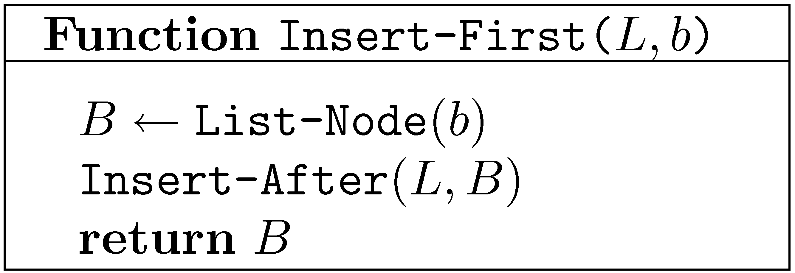
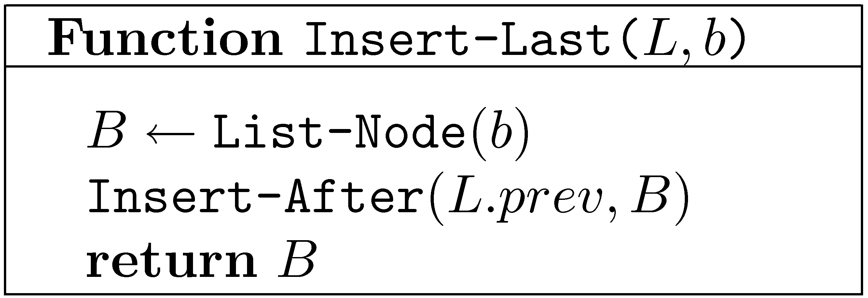
Implementing lists with handles using circular doubly linked lists
L
a₁
a₂
a₃
…
a_{n-1}

Slide 37
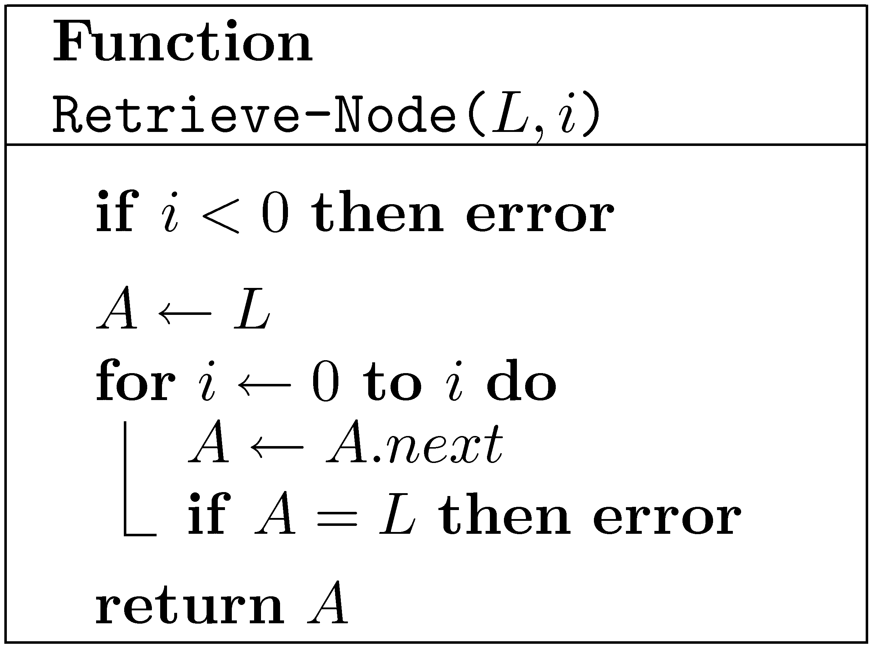
Implementing lists with handles using circular doubly linked lists
L
a₁
a₂
a₃
…
a_{n-1}
Implement Insert(L,i)

Slide 38
Pitfalls of the new ADT
L₁
A
a₁
a₂
a₃
…
a_{n-1}
L₂
B
b₁
b₂
b₃
…
b_{m-1}
Insert-After(A,B)
L₂ is not a valid list now
Should call Delete(B) before Insert-After(A,B)

Slide 39
Implementing lists using (circular) arrays with resizing
n
L
array
a₀
a₁
…
a_{M−1}
maxlen
M
length
M
M
What do we do when the array is full?
We cannot extend the array.
Allocate a larger array and copy
What should be the size of the new array?

Slide 40
Implementing lists using (circular) arrays with resizing
n
L
array
a₀
a₁
…
a_{M−1}
maxlen
M
length
M
M
If we start with an empty array and increase its length by 1, then the time to do n Insert-Last is about:

Slide 41
Implementing lists using (circular) arrays with doubling
When the array is full, double its size and copy
What is the cost of n Insert-Last operations?
Assume, for simplicity that n=2^{k}
cost of insertion
cost of copying
The average/amortized cost of each operation is O(1)

Slide 42
Worst-case bounds
Suppose that a data structure supports k different types of operations T₁, T₂,…,T_{k}
Let worst(T_{i}), the maximal time that a single operation of type T_{i} may take.
Let op₁, op₂,… op_{n} be a sequence of operations that includes n_{i} operations of type T_{i}.
Sometimes, this bound is very loose.

Slide 43
Amortized bounds
We say that amort(T_{i}) is an amortized bound on the cost of operation of type T_{i} iff for every valid sequence of operations op₁, op₂,… op_{n} be sequence of operations including n_{i} operations of type T_{i} we have
Note: Amortized bounds are bounds, they are not unique

