Slide 1
Union-Find A data structure for maintaining a collection of disjoint sets
Course: Data Structures Lecturers: Haim Kaplan and Uri Zwick June 2010

Slide 2
Union-Find
Make(x): Create a set containing x
Union(x,y): Unite the sets containing x and y
Find(x): Return a representative of the set containing x
Find(x)=Find(y) iff x and y are currently in same set
Variation:
Make and Union specify a name for new set
Find(x) returns name of set containing x

Slide 3
Union Find
a
b
c
d
e

Slide 4
Union-Find
Make
Link
Find
O(1)
O(log n)
O(1)
O(1)
O(1)
O(log n)
O(1)
O(1)
O(α(n))
Amortized
Worst Case
Amortized
Link(x,y): Unite the sets containing the representatibe elements x and y
Union(x,y) → Link(Find(x),Find(y))

Slide 5
Important aplication: Incremental Connectivity
A graph on n vertices is build by adding edges
At each stage we may want to know whether two given vertices are already connected
2
5
1
4
7
3
6
union(1,2)
union(2,7)
Find(1)=Find(6)?
union(3,5)
…

Slide 6
Fun aplication: Generating mazes
make(1)
1 | 2 | 3 | 4
5 | 6 | 7 | 8
9 | 10 | 11 | 12
13 | 14 | 15 | 16
make(2)
…
make(16)
find(6)=find(7) ?
union(6,7)
find(7)=find(11) ?
union(7,11)
…
Choose edges in random order and remove them if they connect two different regions

Slide 7
Fun aplication: Generating mazes
1 | 2 | 3 | 4
5 | 6 | 7 | 8
9 | 10 | 11 | 12
13 | 14 | 15 | 16

Slide 8
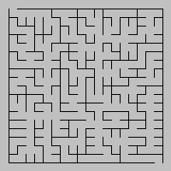
Generating mazes – a larger example
n
Construction time -- O(n² α(n²))

Slide 9
More serious aplications:
Maintaining an equivalence relation
Incremental connectivity in graphs
Computing minimum spanning trees
…

Slide 10
Implementation using linked lists
Each set is represented as a linked list
Each element has a pointer to the list
Set
first
last
size
k
…
a
x
z
c
Find(x) – O(1) time

Slide 11
Union using linked lists
first
last
size
k₁
a
x
z
…
c
first
last
size
k₂
b
c
y
Concatenate the two lists
Change “set pointers” of shorter list
Union(x) – O(min{k₁,k₂}) time

Slide 12
Union Find
Represent each set as a rooted tree
Union by rank
Path compression
p[x]
x
The parent of a vertex x is denoted by p[x]
Find(x) traces the path from x to the root

Slide 13
Union by rank
r+1
r₂
r
r
0
r₁
r₁< r₂
Union by rank on its own gives O(log n) find time
A tree of rank r contains at least 2^{r} elements
If x is not a root, then rank(x)<rank(p[x])

Slide 14
Path Compression

Slide 15
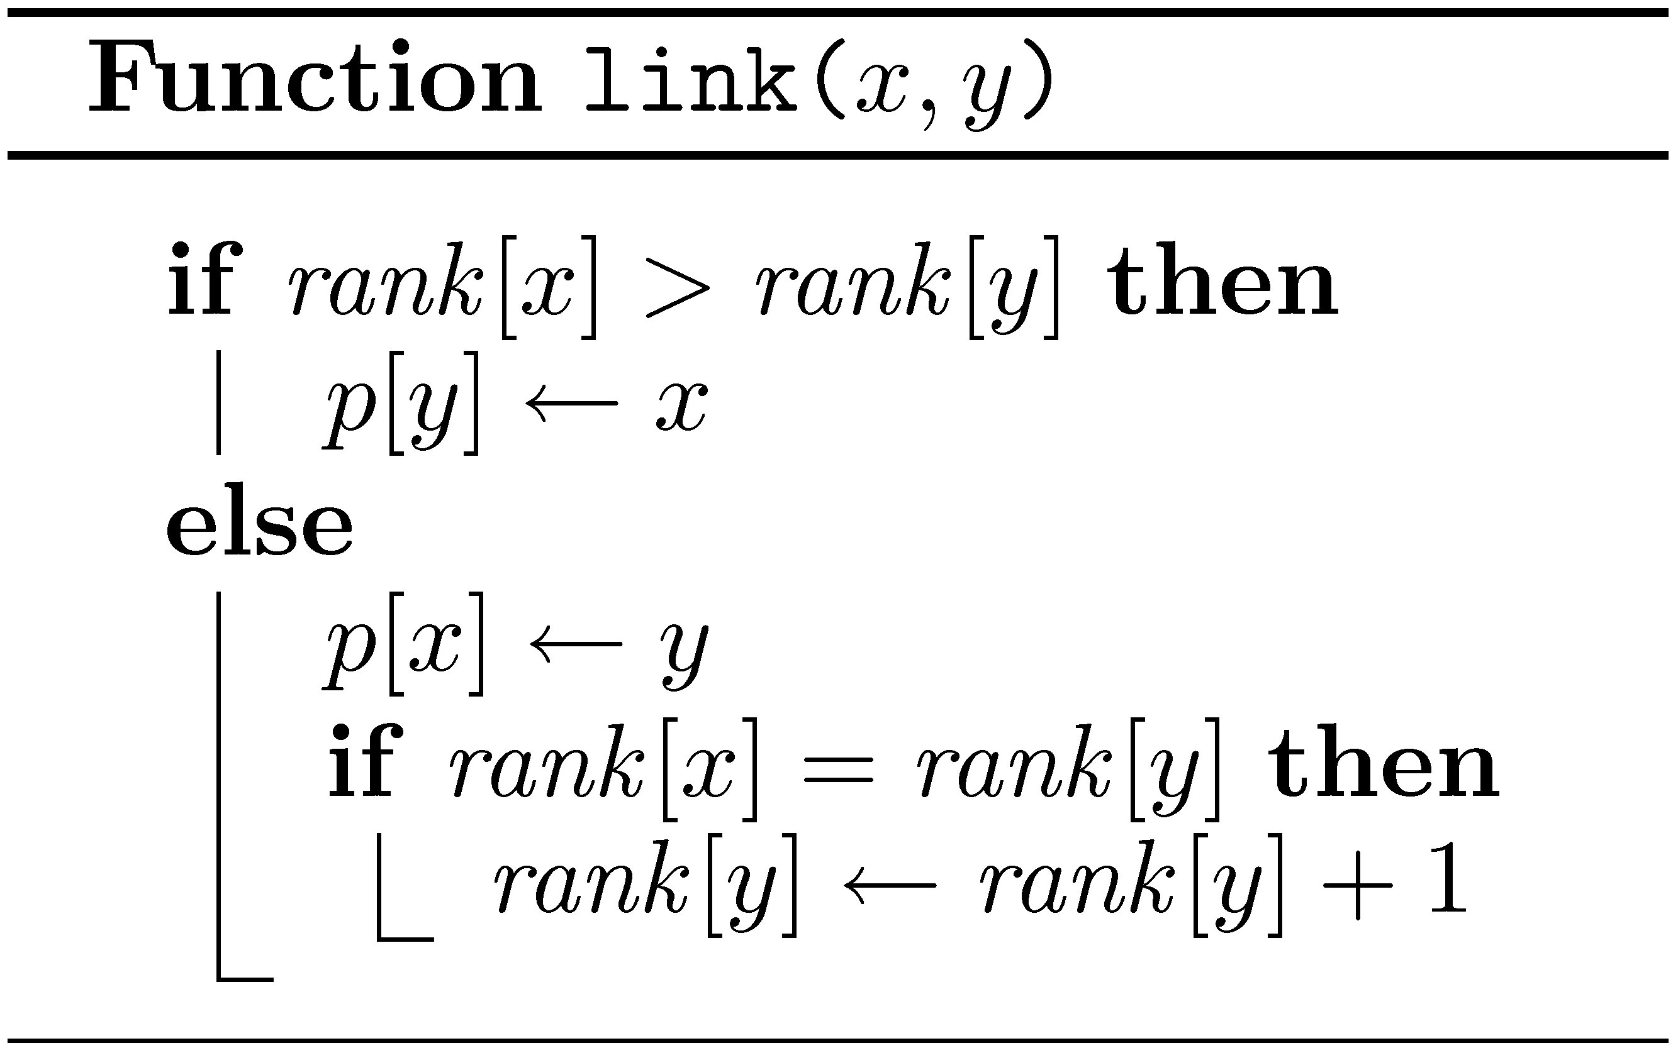
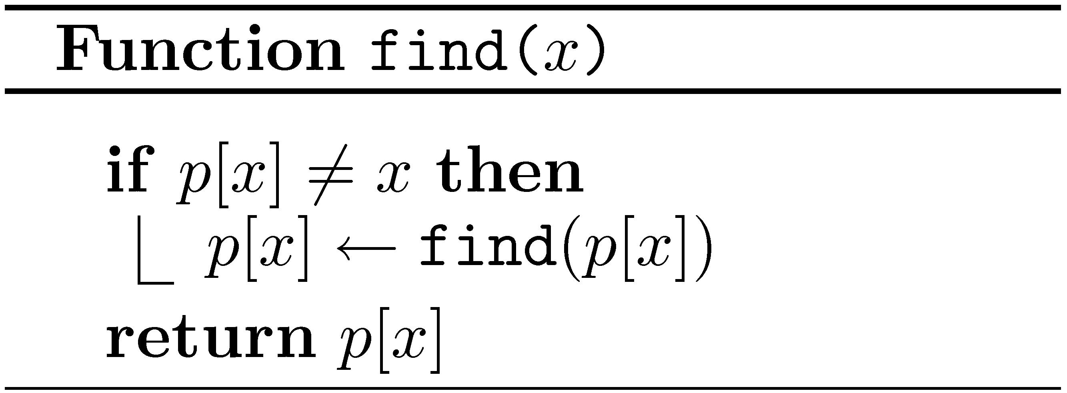
Union Find - pseudocode

Slide 16
Union-Find
Worst case
make | link | find
O(1) | O(1) | O(log n)
Amortized
make | link | find
O(1) | O(α(n)) | O(α(n))

Slide 17
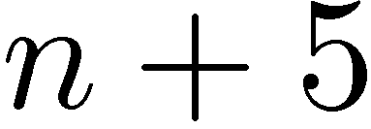
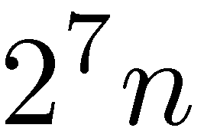
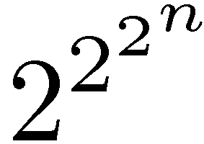
Nesting / Repeated application

Slide 18
Ackermann’s function

Slide 19
Ackermann’s function (modified)

Slide 20
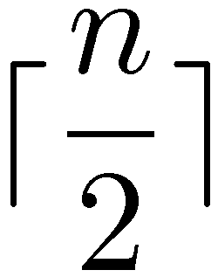
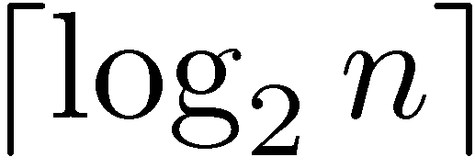
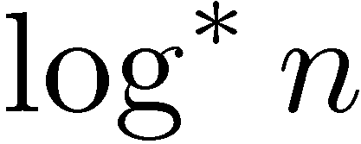
Inverse functions

Slide 21
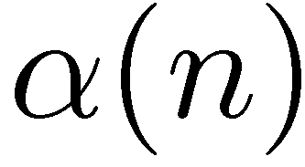
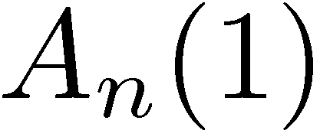
Inverse Ackermann function
is the inverse of the function
A “diagonal”
The first “column”

Slide 22
Amortized analysis
Actual cost of i-th operation
Amortized cost of i-th operation
Potential after i-th operation

Slide 23
Amortized analysis (cont.)
Total actual cost

Slide 24
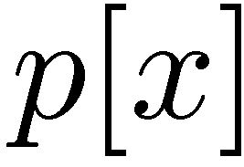
Level and Index
Back to union-find…

Slide 25
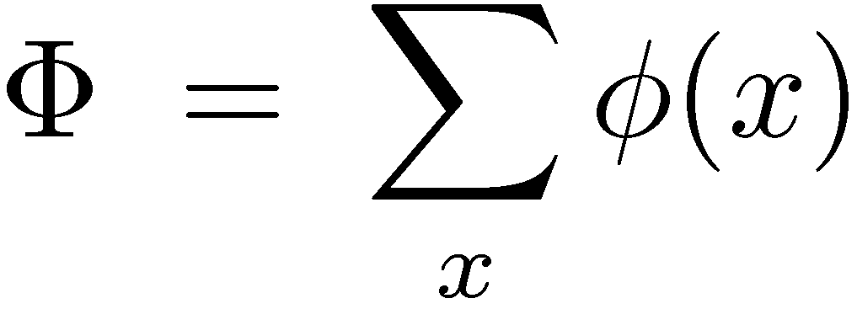
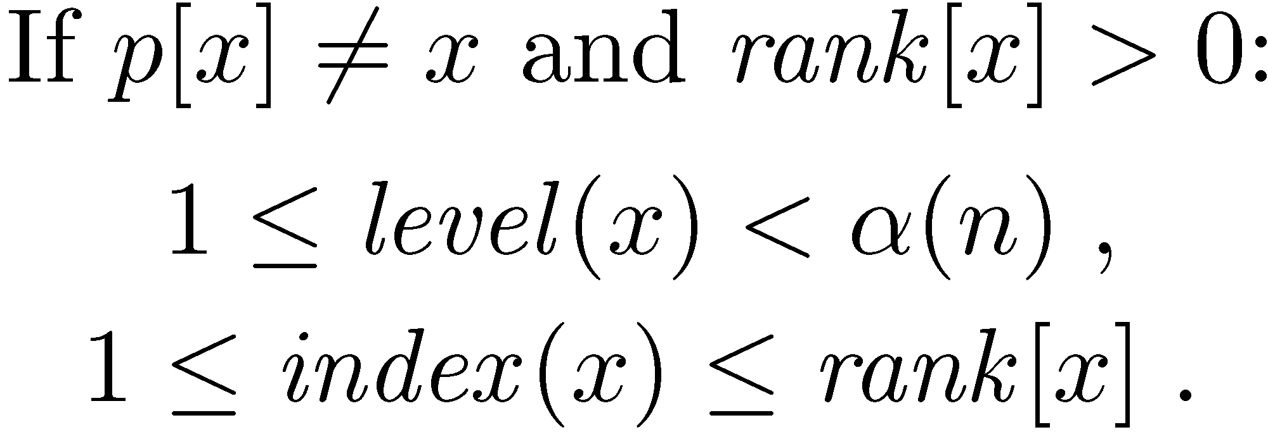
Potentials

Slide 26
Bounds on level
Definition
Proof
Claim

Slide 27
Bounds on index

Slide 28
Amortized cost of make
Actual cost: O(1)
ΔΦ: 0
Amortized cost: O(1)

Slide 29
Amortized cost of link
x
y
Actual cost: O(1)
z₁
…
z_{k}
The potentials of y and z₁,…,z_{k} can only decrease
The potentials of x is increased by at most α(n)
ΔΦ ≤ α(n)
Amortized cost: O(α(n))

Slide 30
Amortized cost of find
y=p’[x]
rank[x] is unchanged
rank[p[x]] is increased
level(x) is either unchanged or is increased
p[x]
If level(x) is unchanged, then index(x) is either unchanged or is increased
x
If level(x) is increased, then index(x) is decreased by at most rank[x]–1
is either unchanged or is decreased

Slide 31
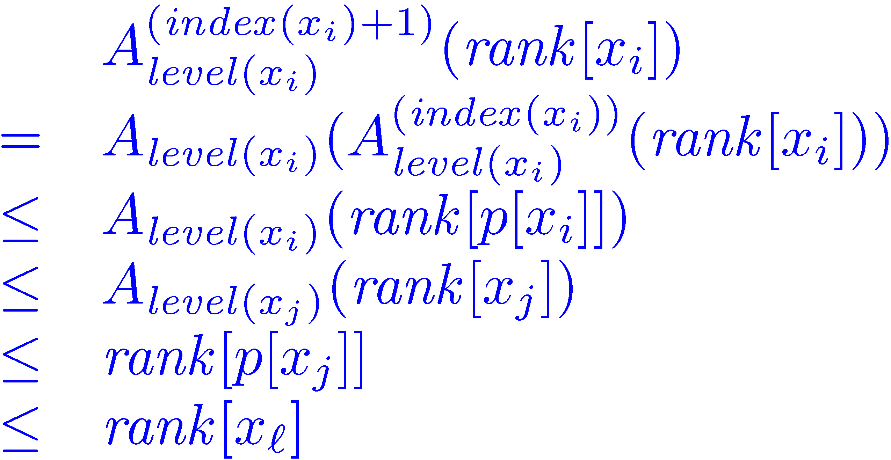
Amortized cost of find
Suppose that:
x_{l}
x_{j}
x_{i}
x=x₀
φ(x) is decreased !

Slide 32
Amortized cost of find
x_{l}
x_{j}
x_{i}
The only nodes that can retain their potential are: the first, the last and the last node of each level
x=x₀
Actual cost: l +1
ΔΦ ≤ (α(n)+1) – (l +1)
Amortized cost: α(n)+1

