Slide 1
Hashing
Course: Data Structures Lecturer: Haim Kaplan and Uri Zwick May 2010
TexPoint fonts used in EMF.
Read the TexPoint manual before you delete this box.: AA

Slide 2
Dictionaries
D ← Dictionary() – Create an empty dictionary
Insert(D,x) – Insert item x into D
Find(D,k) – Find an item with key k in D
Delete(D,k) – Delete item with key k from D
(Predecessors and successors, etc., not required)
Can use balanced search trees O(log n) time per operation
Can we do better?
YES !!!

Slide 3
Dictionaries with “small keys”
Suppose all keys are in {0,1,…,m−1}, where m=O(n)
Can implement a dictionary using an array D of length m.
0
1
m-1
Special case: Sets D is a bit vector
O(1) time per operation (after initialization)
(Assume different items have different keys.)
What if m>>n ?
Use a hash function

Slide 4
Hashing
Huge universe U
Hash function h
Collisions
0
1
m-1
Hash table

Slide 5
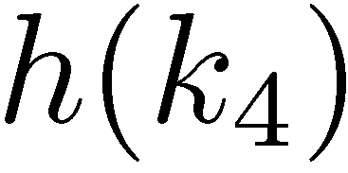
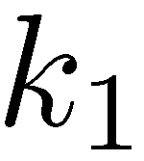
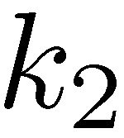
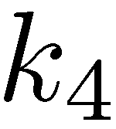
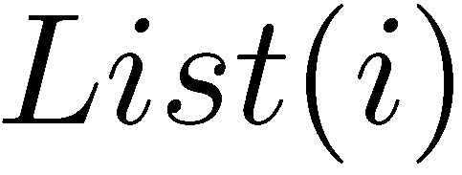
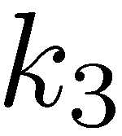
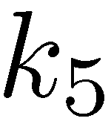
Hashing with chaining
Each cell points to a linked list of items
0
1
i
m-1

Slide 6
What makes a hash function good?
Should behave like a “random function”
Should have a succinct representation
Should be easy to compute
Usually interested in families of hash functions
Allows rehashing, resizing, …

Slide 7
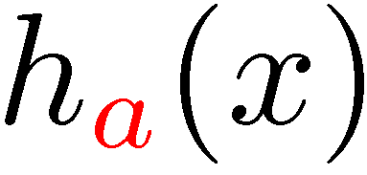
Simple hash functions
The modular method
×
The multiplicative method

Slide 8
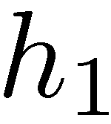
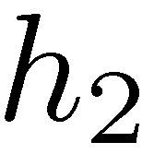
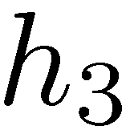
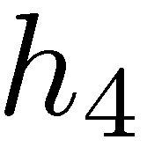
Tabulation based hash functions
“byte”
…
Can be used to hash strings
…
h_{i} can be stored in a small table
+

Slide 9
Universal families of hash functions
A family H of hash functions from U to [m] is said to be universal if and only if

Slide 10
A simple universal family
To represent a function from the family we only need two numbers, a and b.
The size m of the hash table is arbitrary.

Slide 11
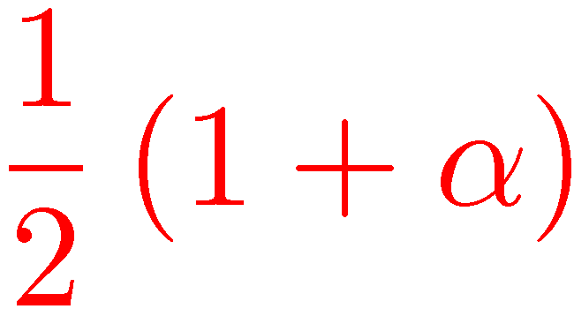
Probabilistic analysis of chaining
n – number of elements in dictionary D
m – size of hash table
α=n/m – load factor
Assume that h is randomly chosen from a universal family H
 | Expected | Worst-case
Successful Search Delete
Unsuccessful Search (Verified) Insert

Slide 12
Chaining: pros and cons
Pros:
Simple to implement (and analyze)
Constant time per operation (O(n/m))
Fairly insensitive to table size
Simple hash functions suffice
Cons:
Space wasted on pointers
Dynamic allocations required
Many cache misses

Slide 13
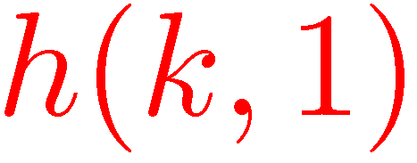
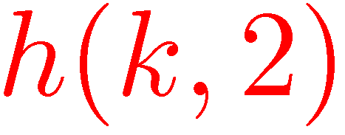
Hashing with open addressing
Hashing without pointers
Insert key k in the first free position among
Assumed to be a permutation
No room found → Table is full
To search, follow the same order

Slide 14
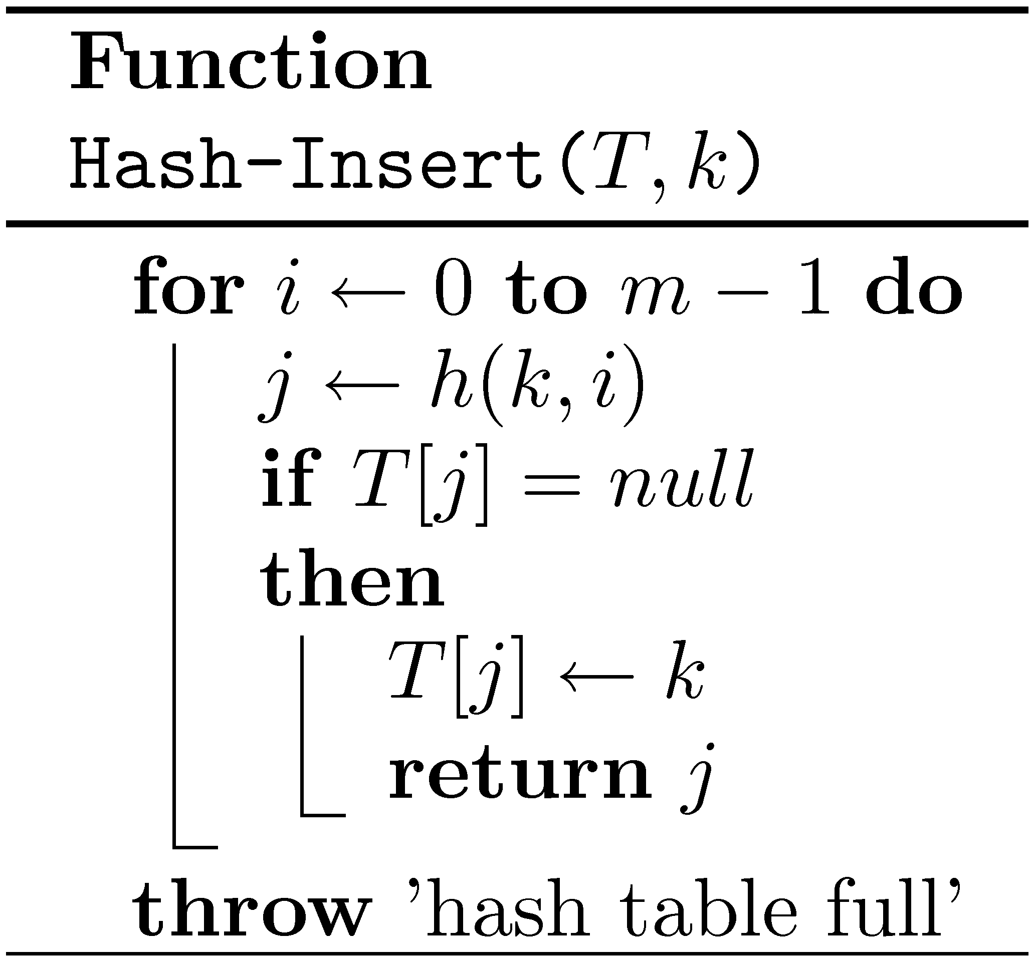
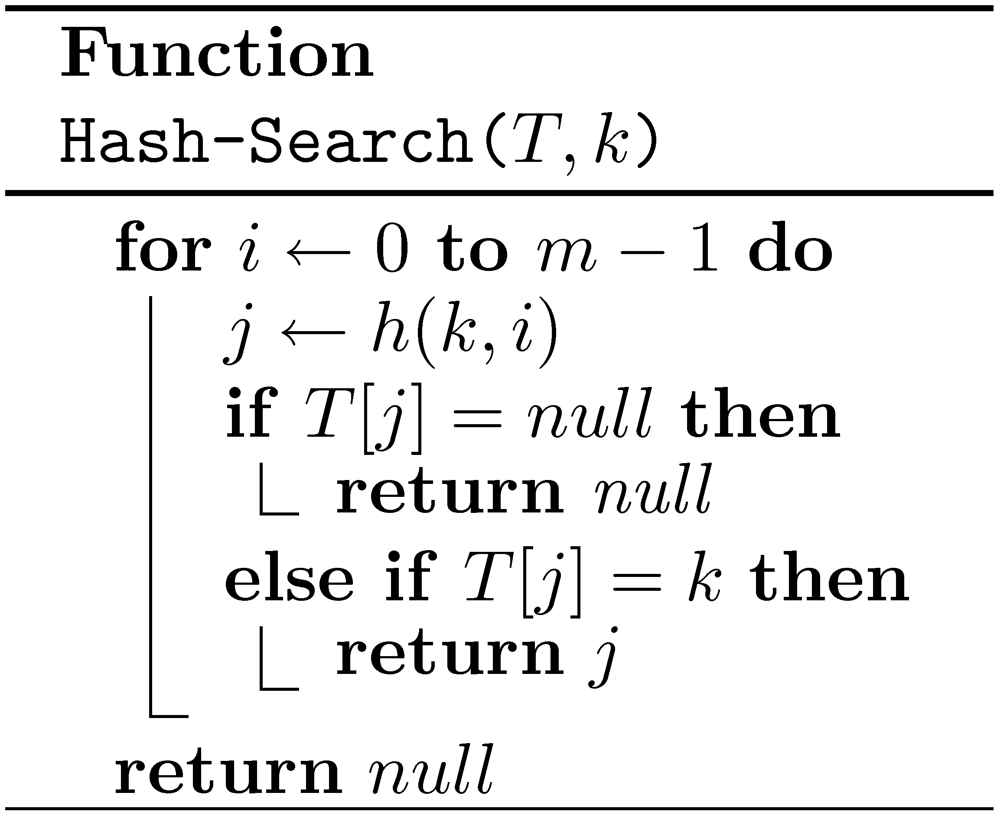
Hashing with open addressing

Slide 15
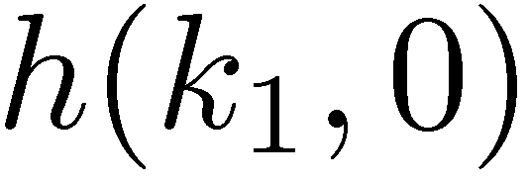
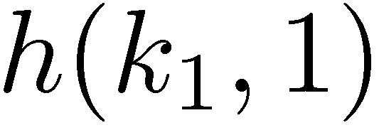
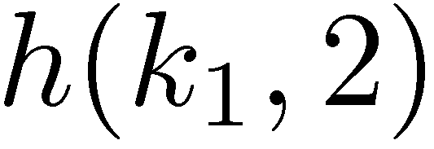
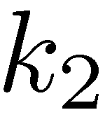
How do we delete elements?
Caution: When we delete elements, do not set the corresponding cells to null!
“deleted”
Problematic solution…

Slide 16
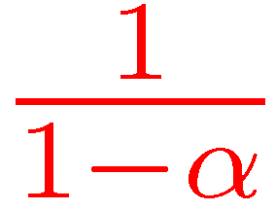
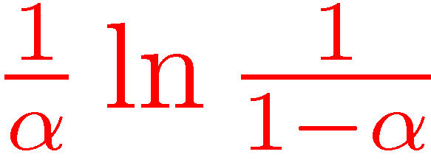
Probabilistic analysis of open addressing
n – number of elements in dictionary D
m – size of hash table
α=n/m – load factor (Note: α≤1)
Uniform probing: Assume that for every k, h(k,0),…,h(k,m-1) is random permutation
Expected time for unsuccessful search
Expected time for successful search

Slide 17
Probabilistic analysis of open addressing
Claim: Expected no. of probes for an unsuccessful search is at most:
If we probe a random cell in the table, the probability that it is full is α.
The probability that the first i cells probed are all occupied is at most α^{i}.

Slide 18
Open addressing variants
How do we define h(k,i) ?
Linear probing:
Quadratic probing:
Double hashing:

Slide 19
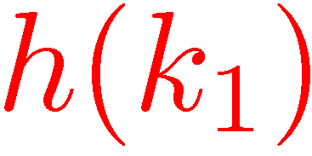
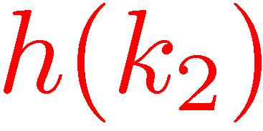
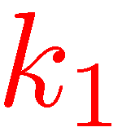
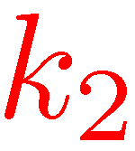
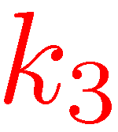
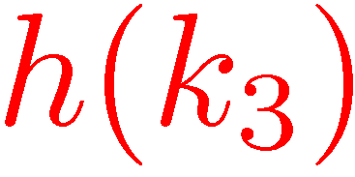
Linear probing “The most important hashing technique”
More probes than uniform probing, as probe sequences “merge”
But, much less cache misses
More complicated analysis (Universal hash families, as defined, do not suffice.)

Slide 20
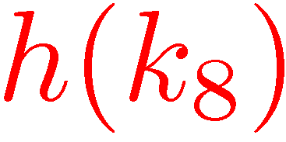
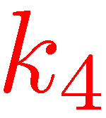
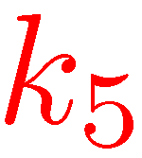
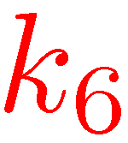
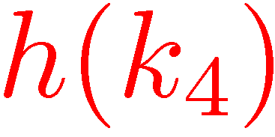
Linear probing – Deletions
Can the key in cell j be moved to cell i?

Slide 21
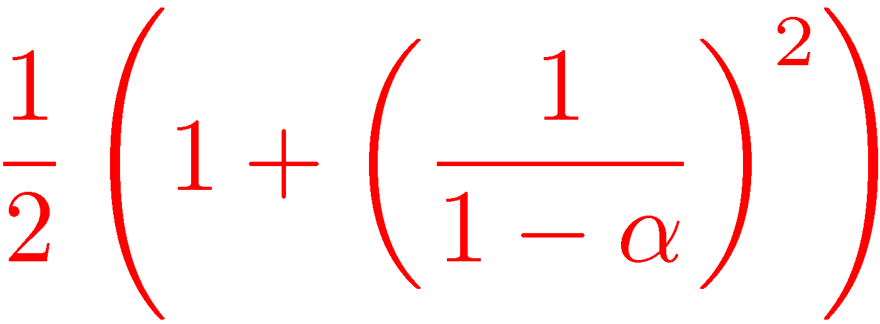
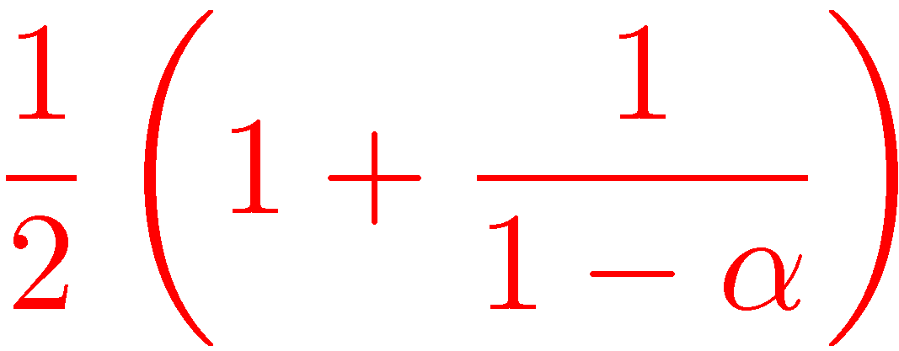
Expected number of probes
Successful Search | Unsuccessful Search
 |  | Uniform Probing
 |  | Linear Probing
When, say, α≤0.6, all small constants

Slide 22
Expected number of probes

Slide 23
Perfect hashing
Suppose that D is static.
We want to implement Find is O(1) worst case time.
Perfect hashing: No collisions
Can we achieve it?

Slide 24
Expected no. of collisions

Slide 25
Expected no. of collisions
If we are willing to use m=n², then any universal family contains a perfect hash function.
No collisions!

Slide 26
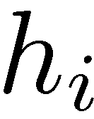
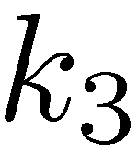
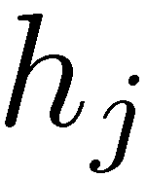
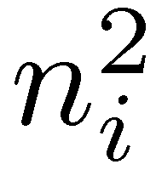
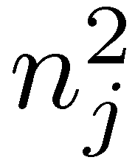
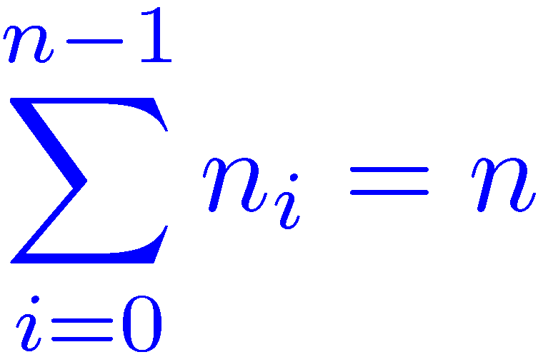
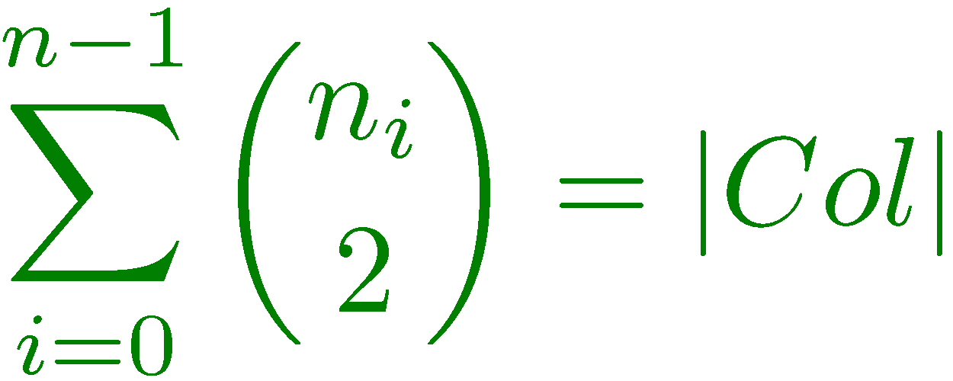
Two level hashing [Fredman, Komlós, Szemerédi (1984)]

Slide 27
Two level hashing [Fredman, Komlós, Szemerédi (1984)]

Slide 28
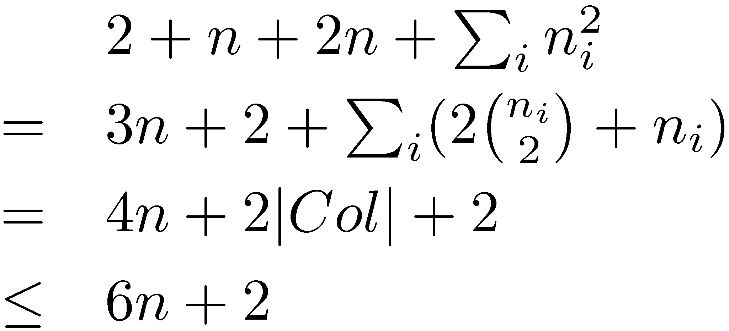
Two level hashing [Fredman, Komlós, Szemerédi (1984)]
Assume that each h_{i} can be represented using 2 words
Total size:

Slide 29
A randomized algorithm for constructing a perfect two level hash table:
Choose a random h from H(n) and compute the number of collisions. If there are more than n collisions, repeat.
For each cell i,if n_{i}>1, choose a random hash function from H(n_{i}²). If there are any collisions, repeat.
Expected construction time – O(n)
Worst case search time – O(1)

Slide 30
Other applications of hashing
Comparing files
Cryptographic applications
…

