Slide 1
Selection Find the k-th largest element
Course: Data Structures Lecturer: Haim Kaplan and Uri Zwick May 2010
TexPoint fonts used in EMF.
Read the TexPoint manual before you delete this box.: AA

Slide 2
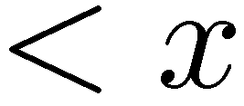
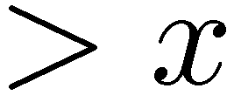
Quick-Select
Expected linear time

Slide 3
Deterministic Selection in linear time
Blum, Floyd, Pratt, Rivest, Tarjan (1973)

Slide 4
Partition the elements into 5-tuples
6
2
9
5
1

Slide 5
Sort the 5-tuples
9
6
5
2
1

Slide 6
Recursively find the median of the medians
9
6
5
2
1

Slide 7
Recursively find the median of the medians
9
6
1
3
2
5
7
10
11
2
1

Slide 8
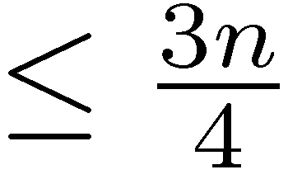
Partition around the median of the medians
5
Continue recursively with the side that contains the k-th element

Slide 9
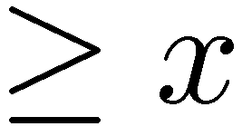
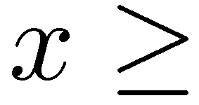
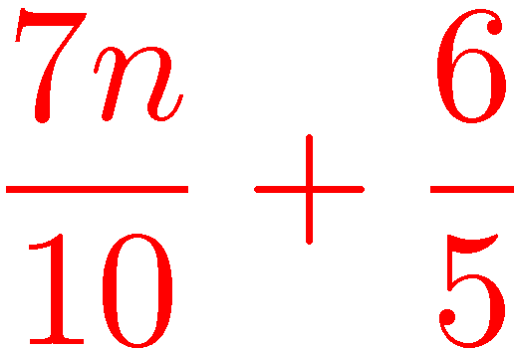
Fairly balanced partition
9
6
1
3
2
x
7
10
2
1
At least
At most
elements
elements

Slide 10
Analysis

