Slide 1
Sorting
Course: Data Structures Lecturer: Haim Kaplan and Uri Zwick May 2010
TexPoint fonts used in EMF.
Read the TexPoint manual before you delete this box.: AA

Slide 2
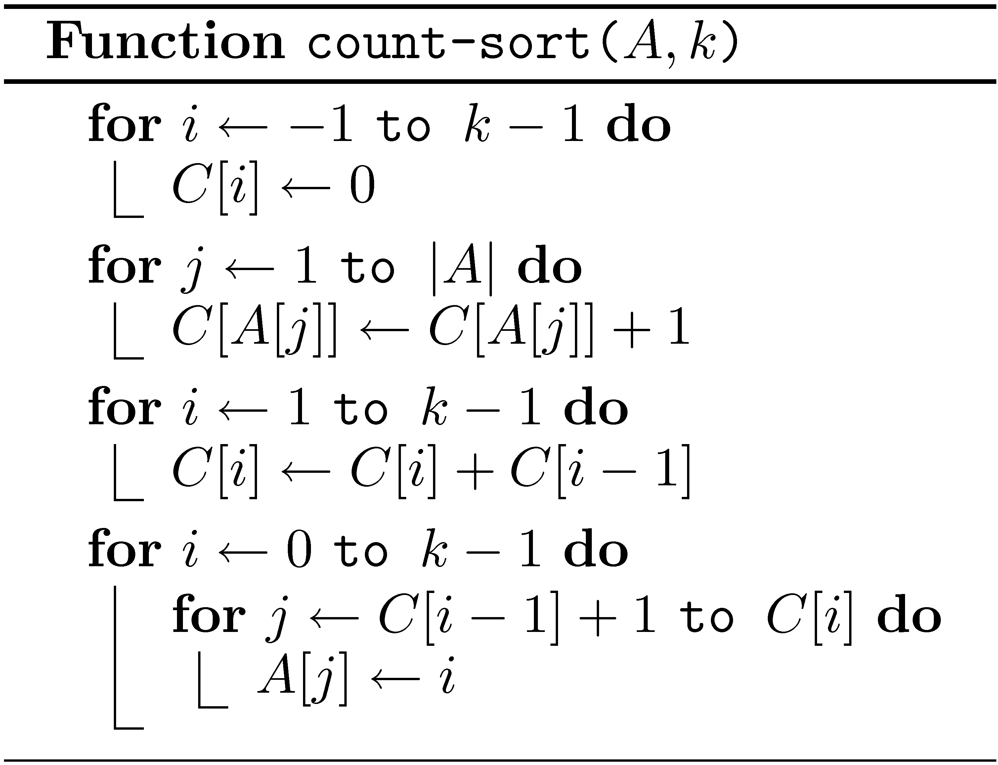
Count-Sort
Suppose that all the elements in A are in {0,1,…,k-1}
Time = O(n+k)

Slide 3
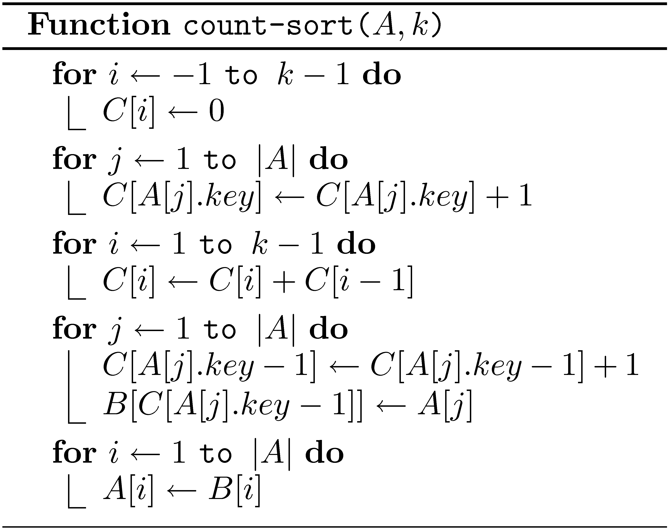
Count-Sort with satellite info
Time = O(n+k)
Stable!

Slide 4
Radix Sort
Suppose each key is composed of k digits in base R.
Digit k−1
Digit 1
Digit 0
Digit-sort sort Stably according to the i-th digit!
Can use an adaptation of count-sort
Note: Start with least significant digit
Time = O(k(n+R))

