Slide 1
Integrity for Car-Computing A cryptographic vision for integrity in vehicle networks
Eran Tromer
Transportation CybserSecurity 18 Feb 2014

Slide 2
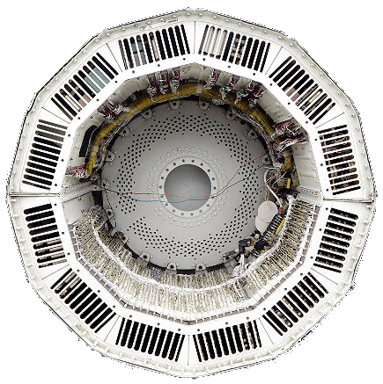
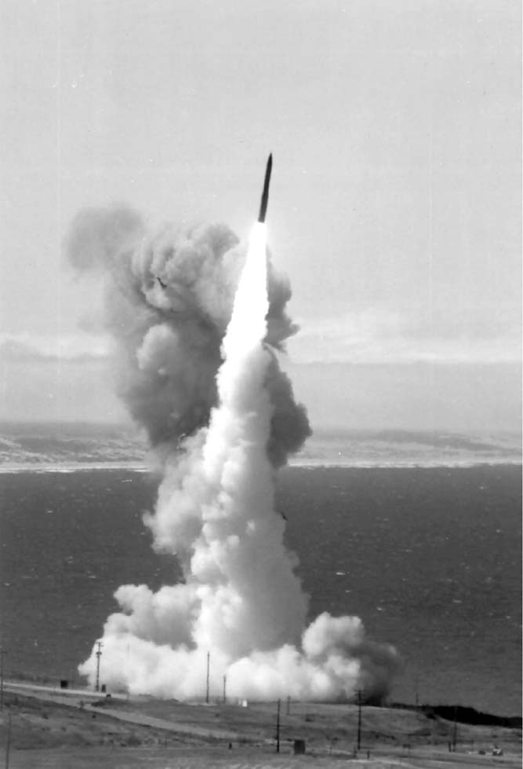
The first vehicle computer
D-17B Minuteman I guidance system

Slide 3
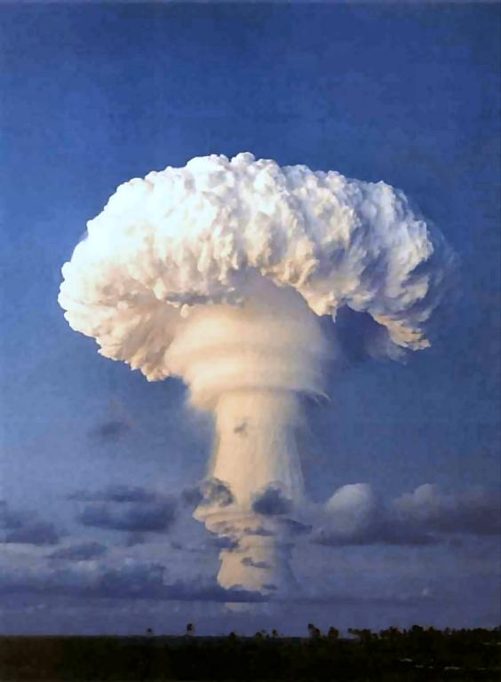
The first vehicle computer
D-17B Minuteman I guidance system

Slide 4
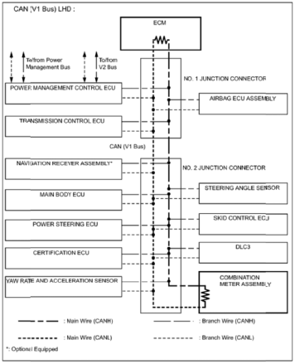
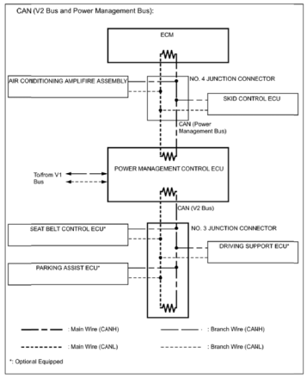
In-car integrity
Modern cars contain dozens of Electronic Control Units
Chinese counterfeit chips causing military hardware crashes
[…]
Component failure reports from defense contractors worldwide, including Boeing, Raytheon, BAE, Northrop Grumman, and Lockheed […] and investigations have turned up a significant number of counterfeit parts, sometimes installed in mission-critical systems.
Can you trust them?
Hardware supply chain
Bad software
Errors
Toyota's Killer Firmware:
Bad Design & Its Consequences
[…] Oklahoma court ruled against Toyota in a case of unintended acceleration that led to the death of one of the occupants. Central to the trial was the Engine Control Module's (ECM) firmware.
Bad updates
Attacks
Notes:
Toyota Prius 2010 [Miller Valasek 2013]

Slide 5
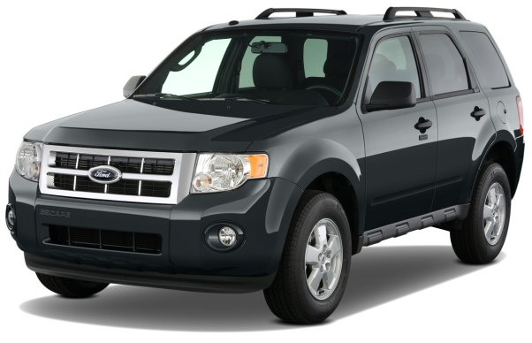
Example: engaging ABS
See [Miller Valasek 2013]
PAM ECU
Parking Aid Module
Transmission
Parking brake switch
Brake pedal switch
PSCM ECU
Power Steering Control Module
SJB ECU Smart Junction Box
PCM ECU Powertrain Control Module
Accelerator pedal position sensor
07 36: 0B 34 00 44 … “SJB ECU: Program firmware”
07 36: 03 B1 7E 80 … “SJB ECU: Crash”
Brake pedal position sensor
ABS ECU Anti-Lock Brake System
07 60: 04 B1 00 3C FF ... “ABS ECU: Engage brakes fully”
Notes:
Ford Escape 2010 [Miller Valasek 2013]

Slide 6
Approach: proof-carrying data
“My message is […] and here’s a proof that I computed it correctly”
“My message is […] and here’s a proof that I computed it correctly.”
PAM ECU
Parking Aid Module
Transmission ECU
Parking brake switch
Brake pedal switch
“My message is […] and here’s a proof that I computed it correctly based on a correct message from the Transmission ECU and signed sensor data”
sig
PSCM ECU
Power Steering Control Module
SJB ECU Smart Junction Box
PCM ECU Powertrain Control Module
Accelerator pedal position sensor
sig
sig
…
Brake pedal position sensor
“My message is […] and here’s a proof that I computed it correctly based on a correct message from the PAM ECU”
ABS ECU Anti-Lock Brake System
“My message is BRAKE and here’s proof that it was computed correctly based on all of the above.”
squeeeeeeeal
Notes:
Ford Escape 2010 [Miller Valasek 2013]

Slide 7
Integrity via Proof-Carrying Data
m₃
m₁
m₆
m_{out}
m₄
m₂
m₇
m₅
Diverse network, containing untrustworthy parties and unreliable components.
Enforce correctness of the messages and ultimate results.
Notes:
7

Slide 8
Integrity via Proof-Carrying Data (cont.)
m₃ π₃
m₁ π₁
m₆ π₆
m_{out} π_{out}
m₄ π₄
m₂ π₂
m₇ π₇
m₅ π₅
Every message is augmented with a proof attesting to its compliance” with a prescribed policy.
Compliance can express any property that can be verified by locally checking every node.
Proofs can be verified efficiently and retroactively.
If the final proof is OK, we can trust the result.
Notes:
8

Slide 9
The road to Proof-Carrying Data
Used in Zerocash: anonymous Bitcoin [Ben-Sasson Chiesa Garman Green Miers Tromer Virza 2013]
Feasibility |  |  | Network |  | C program size |  | Program running time |  | Papers
Theory | Proto-type | Fast | 1 hop | Any | Small | Any | Short | Any
✓ |  |  | ✓ |  |  |  |  |  | [Micali 94] [Groth 2010]
✓ |  |  | ✓ | ✓ |  |  |  |  | [Chiesa Tromer 2010]
✓ | ✓ |  | ✓ |  | ✓ |  | ✓ |  | [Ben-Sasson Chiesa Genkin Tromer Virza 2013] [Parno Gentry Howell Raykova 2013]
✓ | ✓ |  | ✓ |  | ✓ | ✓ | ✓ |  | [Ben-Sasson Chiesa Tromer Virza 2014]
✓ | ✓ |  | ✓ | ✓ | ✓ | ✓ | ✓ | ✓ | upcoming
?
The correct execution of arbitrary C programs can be verified in 5 milliseconds using 230-byte proofs.
SCIPR Lab

Slide 10
The road to Proof-Carrying Data on the road
More efficient PCD: cost, latency
Formally defining the critical security properties within a vehicle, and then applying PCD to enforce them
Extending to V2V and V2I
Trusting other cars (that trust other cars (that trust other cars (that trust infrastructure (and other cars) ) ) )
Protecting privacy using zero-knowledge proofs
SCIPR Lab scipr-lab.org

