Slide 1
On Virtual Grey-Box Obfuscation for General Circuits
Nir Bitansky
Ran Canetti
Yael Tauman-Kalai
Omer Paneth

Slide 2
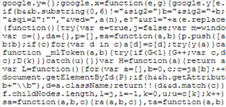
Program Obfuscation
$$x$$
$$\text{y}$$
Program
Obfuscation
$$x$$
$$\text{y}$$
Obfuscated program

Slide 3
Private Key to Public Key
$$m$$
$$\text{cipher}$$
$$Enc_{sk}(m)$$
Obfuscation
$$m$$
$$\text{cipher}$$
Public Key

Slide 4
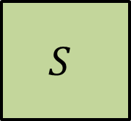
Virtual Black-Box (VBB)
[Hada 00, Barak-Goldreich-Impagliazzo-Rudich-Sahai-Vadhan-Yang 01]
Algorithm $𝒪$ is an obfuscator for a class $𝒞$ if:
For every PPT adversary $A$ there exists a PPT simulator $S$ such that for every $C∈𝒞$ and every predicate $π(C)$:
$$C$$
$$A$$
$$S$$
$$𝒪(C)$$
$$π(C)$$
$$Pr\left[A(𝒪(C))=π\left(C\right)\right]=Pr\left[S^{C}=π\left(C\right)\right]±negl$$

Slide 5
Impossibility Results for VBB
Impossible for some functions. [Barak-Goldreich-Impagliazzo-Rudich-Sahai-Vadhan-Yang 01]
Impossible for all pseudo-entropic functions w.r.t auxiliary input (assuming IO). [Goldwasser-Kalai 05, Bitansky-Canetti-Cohn-Goldwasser-Kalai-P-Rosen 14]

Slide 6
Indistinguishability Obfuscation (IO)
[Barak-Goldreich-Impagliazzo-Rudich-Sahai-Vadhan-Yang 01]
$$C_{1}$$
$$≡$$
$$C_{2}$$
$${𝒪(C}_{1})$$
$$≈_{c}$$
$${𝒪(C}_{2})$$

Slide 7
History
2000-2013:
No general solution.
Obfuscation for simple functions:
[C97,W05,CD08,CRV10,BC10,BR13]
2013:
Candidate obfuscation for all circuits
[Garg-Gentry-Halevi-Raykova-Sahai-Waters 13]

Slide 8
What is the security
of the candidate obfuscator?

Slide 9
Assumption: the [GGHRSW13] obfuscator is IO
Many recent applications:
[Garg-Gentry-Halevi-Raykova-Sahai-Waters 13, Sahai-Waters 13, Hohenberger-Sahai-Waters 13, Garg-Gentry-Halevi-Raykova 13, Bitansky-Canetti-P-Rosen 13, Boneh-Zhandry 13, Brzuska-Farshim-Mittelbach 14, Bitansky-P 14, Ramchen-Waters 14]
Better assumption:
Semantically-secure graded encodings [Pass-Seth-Telang 13]
Multilinear subgroup elimination assumption [Gentry-Lewko-Sahai-Waters 14]

Slide 10
What about other applications?
Example: point function

Slide 11
Can we get more then IO?
Today: virtual grey-box

Slide 12
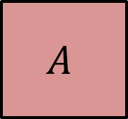
Simulation Definition for IO
[Bitansky-Canetti 10]
$$C_{1}$$
$$≡$$
$$C_{2}$$
$$⇒$$
$${𝒪(C}_{1})$$
$$≈_{c}$$
$${𝒪(C}_{2})$$
Weak VBB:
$$C$$
$$A$$
$$S$$
$$𝒪(C)$$
$$≈$$
Computationally unbounded

Slide 13
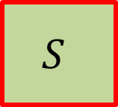
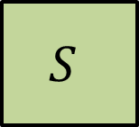
Virtual black-box: Simulator is bounded
$$C$$
$$S$$
polynomial number of oracle queries
[Bitansky-Canetti 10]
Virtual grey-box (VGB): Simulator is semi-bounded
$$C$$
$$S$$
unbounded computation
$$C$$
Indistinguishability:
Simulator is unbounded
$$S$$

Slide 14
Virtual black-box: Simulator is bounded
$$C$$
$$S$$
meaningful
Pseudo-random functions
[Bitansky-Canetti 10]
Virtual grey-box (VGB): Simulator is semi-bounded
$$C$$
Not meaningful
$$S$$
meaningful
Point functions
$$C$$
Not meaningful
Indistinguishability:
Simulator is unbounded
$$S$$

Slide 15
Assume the [GGHRSW13] obfuscation is VGB.
Or better yet, prove it!

Slide 16

Results
Semantically secure
graded encoding
IO
[Pass-Seth-Telang 13]
Semantically secure*
graded encoding
VGB for $NC^{1}$
Semantically secure*
graded encoding
VGB for $NC^{1}$

Slide 17
Results
Semantically secure
graded encoding
IO
[Pass-Seth-Telang 13]
Semantically secure*
mutlilinear jigsaw puzzles
VGB for $NC^{1}$
Semantically secure*
mutlilinear jigsaw puzzles
VGB for all circuits

Slide 18
Results
Semantically secure
graded encoding
IO
[Pass-Seth-Telang 13]
Semantically secure*
mutlilinear jigsaw puzzles
VGB for $NC^{1}$
Semantically secure*
mutlilinear jigsaw puzzles
VGB
Semantically secure
mutlilinear jigsaw puzzles
VBB for new families

Slide 19
New Feasibility Results For VBB
Existing VBB results:
Point functions [Canetti 97, Wee 05]
Constant-size set functions [Bitansky-Canetti 10]
Constant-dimension hyperplanes [Canetti-Rothblum-Varia 10]
New results:
Fuzzy point functions (Hamming balls)
Constant-dimension linear subspaces
Conjunctions (worst-case)
Unified proof for all existing VBB results.

Slide 20
Results
Semantically secure
graded encoding
IO
[Pass-Seth-Telang 13]
Semantically secure*
graded encoding
VGB for $NC^{1}$
Semantically secure*
mutlilinear jigsaw puzzles
VGB
Semantically secure
mutlilinear jigsaw puzzles
VBB for new families

Slide 21
Indistinguishability
Simulation
IND-secure encryption
SIM-secure encryption
[Goldwasser-Micali 82]
Witness indistinguishable proofs
Zero-knowledge proofs
[Feige-Lapidot-Shamir 99]
IND-secure functional encryption
SIM-secure functional encryption
[De Caro-Iovino-Jain-O'Neill-P-Persiano 13]
Indistinguishability obfuscation
Obf. w. Unbounded simulation
[Bitansky-Canetti 10]
?
VGB obfuscation

Slide 22
This work
Strong indistinguishability obfuscation
Virtual grey-box obfuscation

Slide 23
Indistinguishability Obfuscation
For every pair of circuits $C_{1},C_{2}$:
$$∀x: C_{1}\left(x\right)=C_{2}(x)$$
$$𝒪\left(C_{1}\right)≈_{c}𝒪\left(C_{2}\right)$$

Slide 24
Strong Indistinguishability Obfuscation
For every pair of distributions on circuits${\tilde{C}}_{1},{\tilde{C}}_{2}$:
$$∀x: \operatorname{Pr}\left[{ \tilde{C}}_{1}\left(x\right)={ \tilde{C}}_{2}\left(x\right)\right]≥1−\text{negl}\left(\left|x\right|\right)$$
$$𝒪\left({ \tilde{C}}_{1}\right)≈_{c}𝒪\left({ \tilde{C}}_{2}\right)$$

Slide 25
VGB from Semantic Security
Semantically-secure graded encoding*
Strong IO for $NC^{1}$
Virtual grey-box obfuscation for $NC^{1}$

Slide 26
The Equivalence.
Strong indistinguishability obfuscation
Virtual grey-box obfuscation

Slide 27
Strong IO $⇐$ VGB
Let ${\tilde{C}}_{1},{\tilde{C}}_{2}$ be distributions on circuits such that:
$$∀x: \operatorname{Pr}\left[{ \tilde{C}}_{1}\left(x\right)={ \tilde{C}}_{2}\left(x\right)\right]≥1−\text{negl}\left(\left|x\right|\right)$$
For every distinguisher $D:$
$${\tilde{C}}_{1}$$
$${\tilde{C}}_{2}$$
$$𝒪\left({\tilde{C}}_{1}\right)$$
$$D$$
$$≈$$
$$S$$
$$≈$$
$$S$$
$$≈$$
$$D$$
$$𝒪\left({\tilde{C}}_{2}\right)$$

Slide 28
The Equivalence.
Strong indistinguishability obfuscation
Virtual grey-box obfuscation

Slide 29
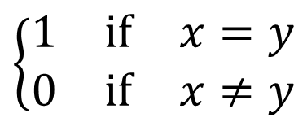
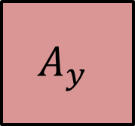
Strong IO $⇒$ VGB: The Challenge
Point Function: $C_{x}(z)$ = $\left\{\begin{matrix}1 & \text{if} & x=z \\ 0 & \text{if} & x≠z\end{matrix}\right.$
$$A_{y}$$
$$\left\{\begin{matrix}1 & \text{if} & x=y \\ 0 & \text{if} & x≠y\end{matrix}\right.$$
$$𝒪(C_{x})$$
$$C_{x}$$
$$S$$
$$\left\{\begin{matrix}1 & \text{if} & x=y \\ 0 & \text{if} & x≠y\end{matrix}\right.$$
$${}_{y}$$

Slide 30
High-Level Simulation Strategy
$$C$$

Slide 31
High-Level Simulation Strategy
$$C$$

Slide 32
High-Level Simulation Strategy
$$C$$

Slide 33
High-Level Simulation Strategy
$$C$$

Slide 34
High-Level Simulation Strategy
$$C$$

Slide 35
High-Level Simulation Strategy
$$C$$
Extract a information about C from the adversary

Slide 36
First Step: Concentrated Functions
A family of boolean functions $D$ is concentrated around a function $f$ if for every input $x$:
$$\underset{C←D}{Pr}\left[C\left(x\right)=f\left(x\right)\right]≥1−\text{negl}(\left|x\right|)$$

Slide 37
Starting Point
$$C$$
The simulator queries $C$ on a “splitting” input

Slide 38
$$C$$
The simulator queries $C$ on a “splitting” input

Slide 39
$$C$$
The simulator queries $C$ on a “splitting” input

Slide 40
$$C$$
The simulator queries $C$ on a “splitting” input

Slide 41
The Concentrated Family
$$C$$
There is no splitting input to query

Slide 42
Warm Up: Point Functions [Canetti 97]
Let $𝒪$ be a strong IO for point functions.
For an adversary $A$ let $B_{A}$ be the set of points $x$ such that:
$$Pr\left[A\left(𝒪\left(C_{x}\right)\right)=1\right]−\operatorname{Pr}\left[A\left(𝒪\left(0\right)\right)=1\right]≥ε$$
How to simulate an obfuscation of $C_{x}$?
If $x∉B_{A}$ simulation is trivial.
if $x∈B_{A}$ the simulator can learn $x$ with a small number of oracle queries.
$$C_{x}$$
$$S$$
$$\left\{\begin{matrix}A(𝒪(C_{x})) & \text{if} & x∈B_{A} \\ A(𝒪(0)) & \text{if} & x∉B_{A}\end{matrix}\right.$$

Slide 43
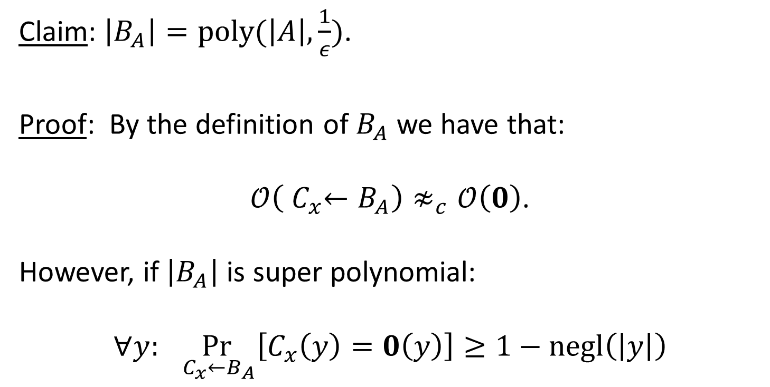
For an adversary $A$ let $B_{A}$ be a set of functions $x$ such that:
$$Pr\left[A\left(𝒪\left(C_{x}\right)\right)=1\right]−\operatorname{Pr}\left[A\left(0\right)=1\right]≥ε$$
Claim: $\left|B_{A}\right|=poly(\left|A\right|, \frac{1}{ε})$.
Proof: By the definition of $B_{A}$ we have that:
$𝒪\left({ C}_{x}←B_{A}\right)≉_{c}𝒪\left(0\right)$.
However, if $\left|B_{A}\right|$ is super polynomial:
$$∀y: \underset{{ C}_{x}←B_{A}}{Pr}\left[C_{x}\left(y\right)=0\left(y\right)\right]≥1−\text{negl}\left(\left|y\right|\right)$$

Slide 44
Main Step: General Concentrated Functions
Let $𝒪$ be a strong IO for $D$.
For an adversary $A$ let $B_{A}$ be the set of functions $C∈D$ s.t:
$$Pr\left[A\left(𝒪\left(C\right)\right)=1\right]−\operatorname{Pr}\left[A\left(𝒪\left(f\right)\right)=1\right]≥ε$$
The set $B_{A}$ may be large!

Slide 45
To simulate an obfuscation of $C∈D$:
If $C∉B_{A}$ simulation is trivial.
if $C∈B_{A}$ then simulator can learn a “separating” input $z$ s.t. $C\left(z\right)≠f(z)$ in a small number of oracle queries.
Set $D_{2}=\left\{C∈D | C\left(z\right)≠f(z)\right\}$. Note: $\left|D_{2}\right|≪\left|D\right|$.
Repeat.

Slide 46
$$D$$
$D_{2}$
$$C\left(z\right)≠f\left(z\right)$$
$$B_{A}$$
$$f_{2}$$
$$B_{A}$$
$$f$$
$$C$$
$$B_{A}$$

Slide 47
$$D$$
$$D_{2}$$
$$C\left(z\right)≠f\left(z\right)$$
$$B_{A}^{2}$$
$$f_{2}$$
$$f$$
$$B_{A}^{2}$$
$$D_{3}$$
$$C$$
$$f_{3}$$
$$C\left(z_{2}\right)≠f_{2}\left(z_{2}\right)$$

Slide 48
$$D$$
$$D_{2}$$
$$C\left(z\right)≠f\left(z\right)$$
$$f_{2}$$
$$f$$
$$D_{3}$$
$$C$$
$$B_{A}^{3}$$
$$f_{3}$$
$$C\left(z_{2}\right)≠f_{2}\left(z_{2}\right)$$

Slide 49
When $C∈B_{A}$, how to learn a separating input
$z$ s.t. $C\left(z\right)≠f(z)$ in a small number of oracle queries?
Claim: There exists a set of separating inputs $Z$ such that:
$\left|Z\right|=poly(\left|A\right|, \frac{1}{ε})$.
For every $C∈B_{A}$, there exists $z∈Z$ such that $C\left(z\right)≠f(z)$
Proof:
By the definition of $B_{A}$ we have that: $𝒪\left(C←B_{A}\right)≉_{c}𝒪\left(f\right)$.
Find an input $z$ that is separating for a noticeable fraction of the functions in $B_{A}$. Such $z$ exists since otherwise:
$$∀z:\underset{c←B_{A}}{Pr}\left[C\left(z\right)=f\left(z\right)\right]≥1−\text{negl}\left(\left|z\right|\right)$$
Add $z$ to $Z$, set $B_{A}=B_{A}∖\left\{C | C\left(z\right)≠f\left(z\right) \right\}$, and repeat.

Slide 50
Two sources of inefficiency
Learning the function:
Finding splitting inputs to concentrate $D_{i}$
Learning the adversary:
Finding the bad set $B_{A}^{i}$
Finding the set of separating inputs $Z_{i}$

Slide 51
Summary
VGB is more meaningful than IO and probably more achievable than VBB.
Strong IO $⇔$ VGB.
More applications of VGB.
The quest for the “right” definition is not over.

Slide 52
Thanks!

