Slide 1
Networks, Crowds and Markets
Undergraduate Seminar in Computer Science
Prof. Ronitt Rubinfeld

Slide 2
What are we here for?

Slide 3
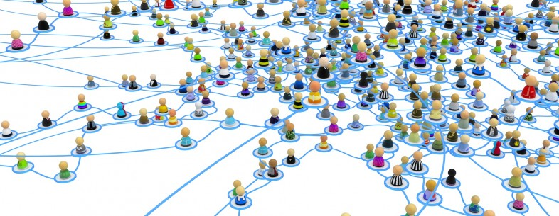
Connections
Taken from http://thenextweb.com/socialmedia/2013/11/24/facebook-grandparents-need-next-gen-social-network/

Slide 4
Networks
Social networks
Connections are “friendship”, “know each other”, “family”
A question: “How important is geography?”
Financial networks
Connections are “bank1 took a loan from bank2”
A question: How susceptible to disruptions, cascading failures, financial crises?
Information networks
Connections are readership, web links
A question: How reliable?

Slide 5
How to represent a network?
Graph theory:
Nodes are entities
Edges are connections
people
Know one another
computers
Network connection
banks
Loan from each other
Facebook pages
Friendship
Wireless routers
Can communicate

Slide 6
Some boring details…
Text is Easley and Kleinberg “Networks, Crowds and Markets”
Talk should be about 45 min
Give a practice talk privately for me on Sunday before (this should not be your first practice talk!)
Will focus on social and information network analysis
Less on game theory, markets and auctions

Slide 7
Giving a talk
Main question: are we awake?
Good material
Delivery: Can we follow?
Monotone voice
Impossible to read slides
Slides organization
Use bullets
How to use vullets?
Must write anything you want them to remember
Ok to rfepeat a definition on board or on slide
At least 24 point font
Practice the talk – at least 2-3 times

