Slide 1
Structure of The World Wide Web
From “Networks, Crowds and Markets”
Chapter 13
Eyal Feder
Nov, 14

Slide 2
What Is the Web?

Slide 4
Not really
The Web != Internet
None of the are made of cats
The World Wide Web is an application of the Internet
https://www.youtube.com/watch?v=lskpNmUl8yQ

Slide 5
Information networks Vs. social networks
The basic units connected (nodes) are pieces of information
The edges symbolize some kind of connection between them
Share a lot of the ideas mentioned in earlier sessions

Slide 6
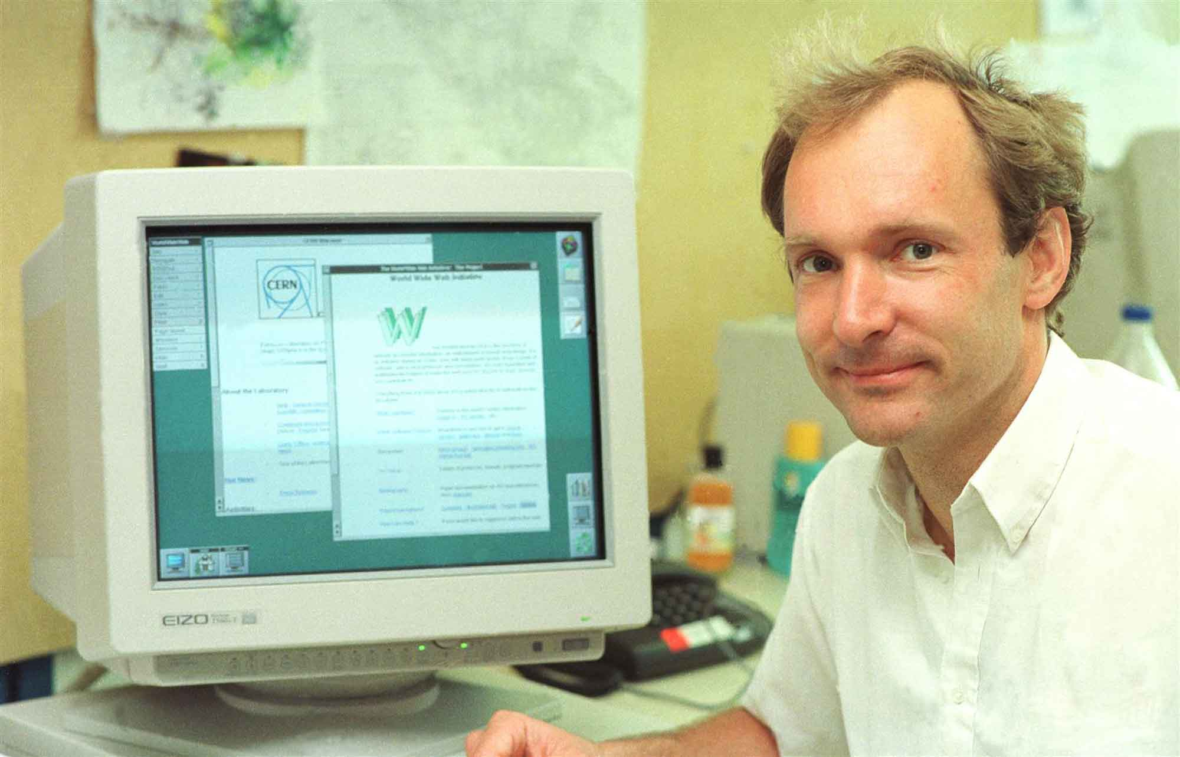
Back to the web
Created by Tim Burners-Lee
A research project in 1989-1991 at CERN
An application of the internet
Two basic features:
Make documents on your computer publically accessible
Easily access these documents using a browser

Slide 7
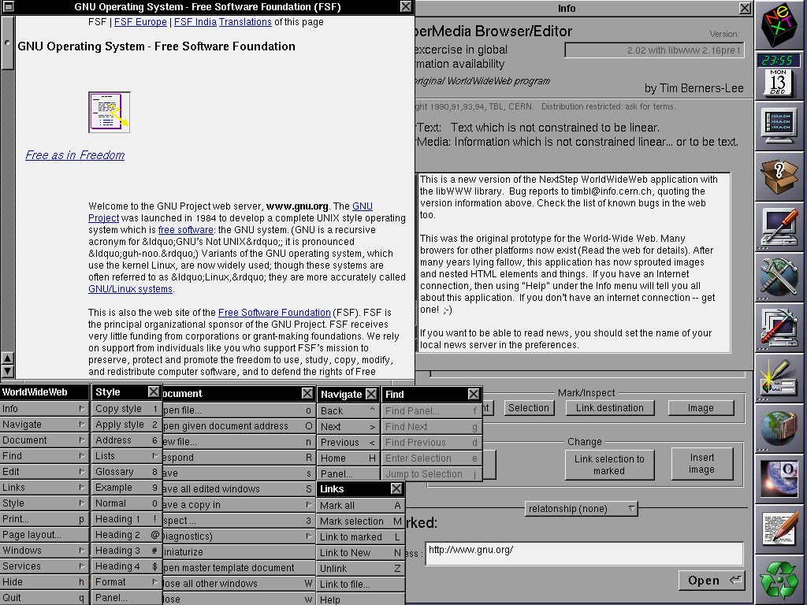
The first browser

Slide 8
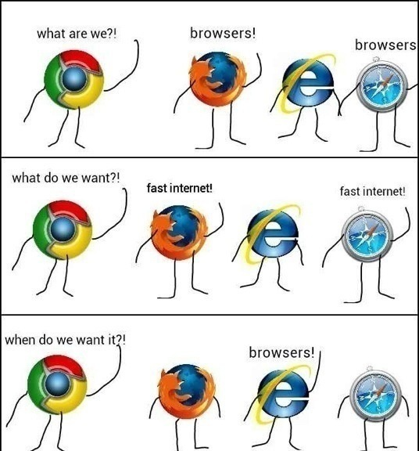
Some are still there

Slide 9
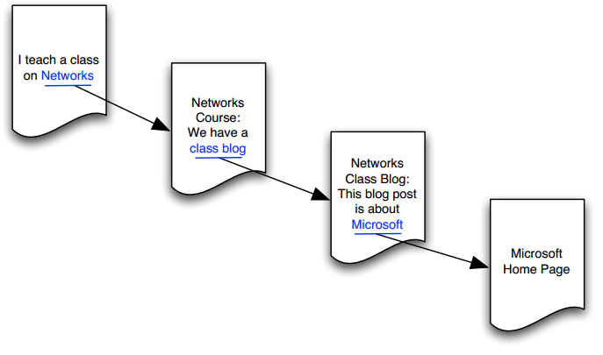
The web as a network
The nodes are documents (pages)
The edges are links (figure 13.2)
How do links work? Hypertext

Slide 10
Hypertext
(The coolest thing about the web)

Slide 11
Different ways to manage information
Alphabetically
Hierarchy (like folders)
Classification systems
All of these have one thing in common
Linearrrr

Slide 12
Earlier non linear connections
Academic references
(also in legal decisions and patents)
Relevant to the web?

Slide 13
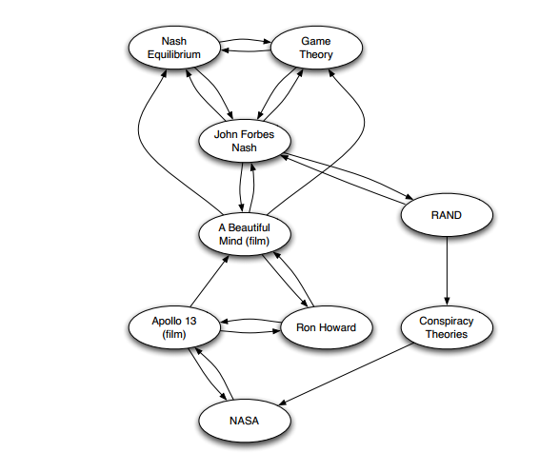
Earlier non linear connections
Cross-reference encyclopedia (figure 13.4)

Slide 14
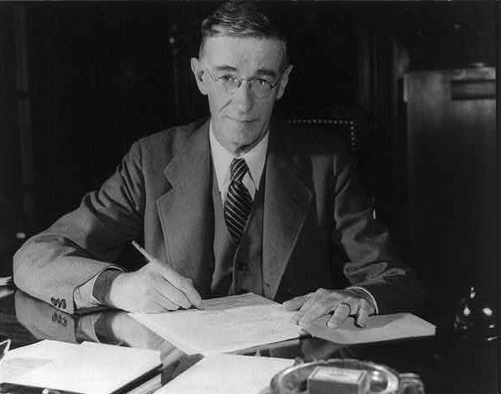
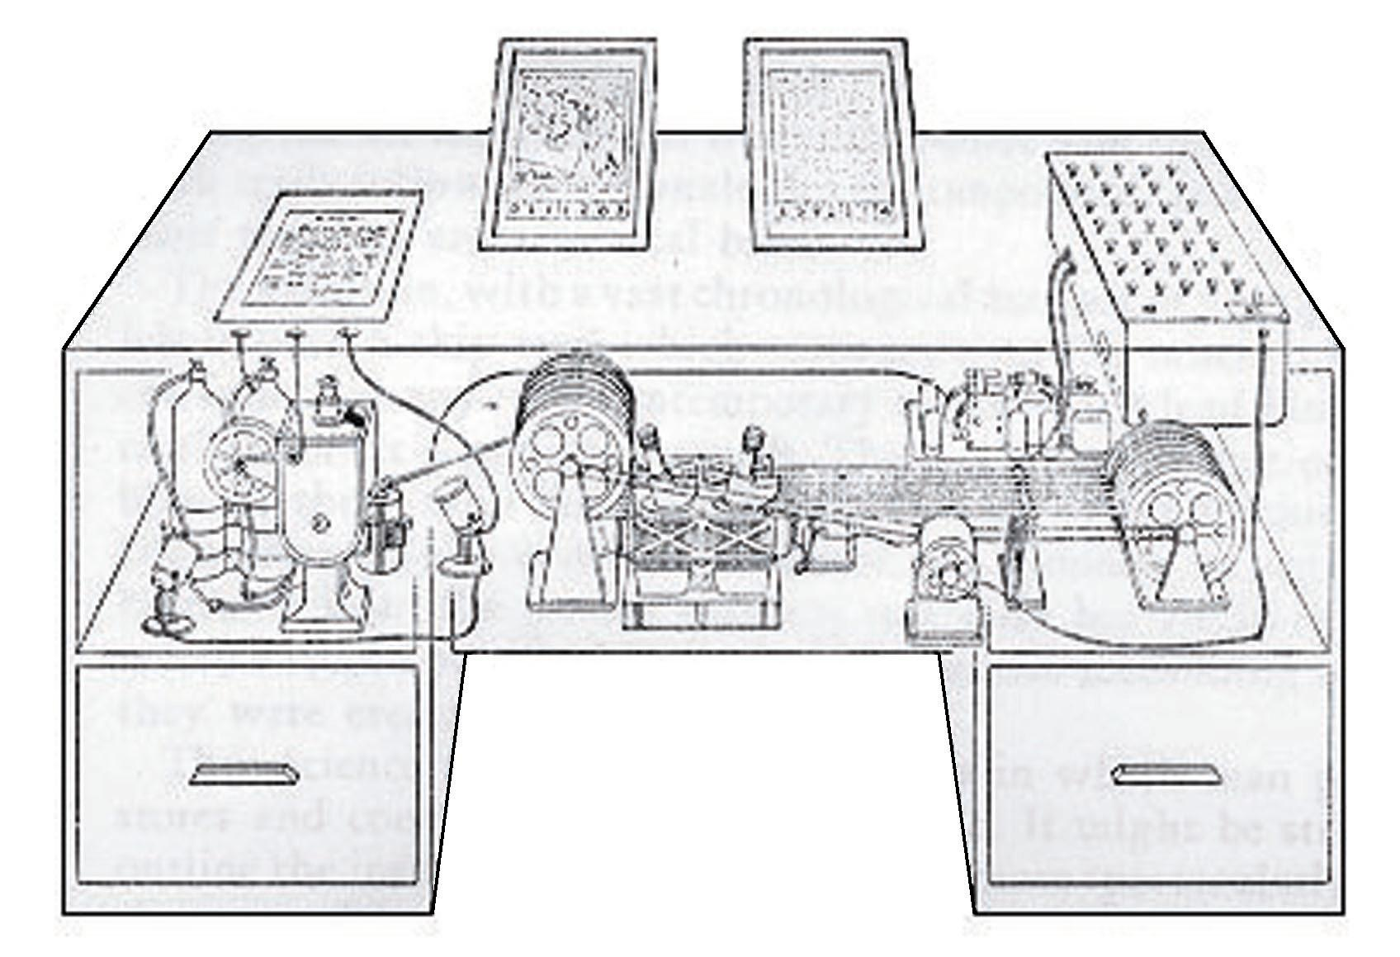
Memex
Vannevar Bush, 1945 Article: “As We May Think”
Our memory is not linear.
Hypothetical model – the Memex
Inspired the idea of hypertext

Slide 15
Introducing: Hypertext
The ultimate reason text is blue.
Invented by Burners-Lee
The way web pages are connected
An associative way to organize information

Slide 16
Changes in the web over time

Slide 17
Static pages >> Query pages
In the early days – static pages of contact
Today?
More and more transactional actions, which create query pages

Slide 18
Importance of static pages
“The Backbone of the Internet”
Reliable over time
Include most links
Navigational vs. transactional
Our focus when thinking about structure

Slide 19
Time for math!
(just a little bit, sorry…)

Slide 20
The web as a directed graph
The best mathematical approximation – a graph
Why directed?

Slide 21
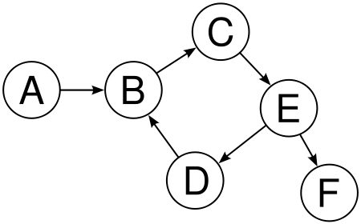
What is a path in a directed graph?
“A Path from node A to a node B in a directed graph is a sequence of nodes, beginig with A and ending with B, with the property that each consecutive pair of nodes in the sequence is connected by an edge pointing in the forward direction”

Slide 22
What is Strong Connectivity in a directed graph?
“A directed graph is Strongly connected if there is a path from every node to every other node”

Slide 23
The Concept of Reachability
Since connectivity does not describe all of the connections in a graph, we need another concept – Reachability
Reachability describes the nodes that are reacheable from a certain node or vice versa
How do we check this?

Slide 24
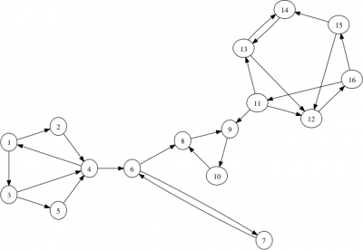
Strongly connected components
Parts of a graph that have strong connectivity
In other words – a group of nodes in which each node is reachable from all other nodes.
Formal:
We say that a strongly connected component (SCC) in a directed graph is a subset of the nodes such that: (i) every node in the subset has a path to every other; and (ii) the subset is not part of some larger set with the property that every node can reach every other.

Slide 25
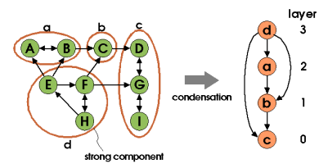
How does all that help us understand the web?
We can map reachability
Using the super-graph

Slide 26
The Bow Tie Structure

Slide 27
History
Short reminder – the Web is not the Internet!
Created in 1999 by Andrei Broder and his colleagues
Used data from biggest search engine back then – AltaVista.
Afterwards – reevaluated many times

Slide 28
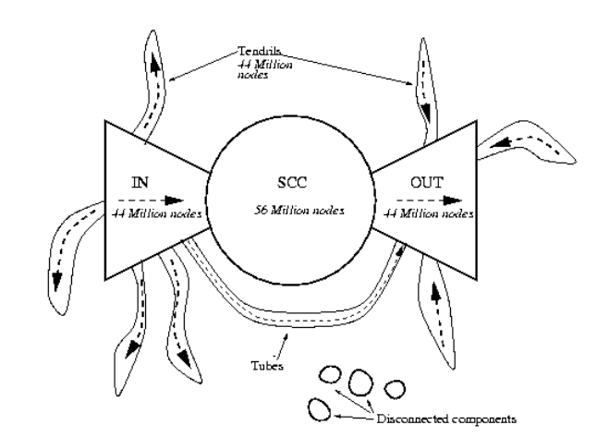
The bow tie structure

Slide 29
Why a giant component?
Counter-intuative, ha?
Let’s think probability

Slide 30
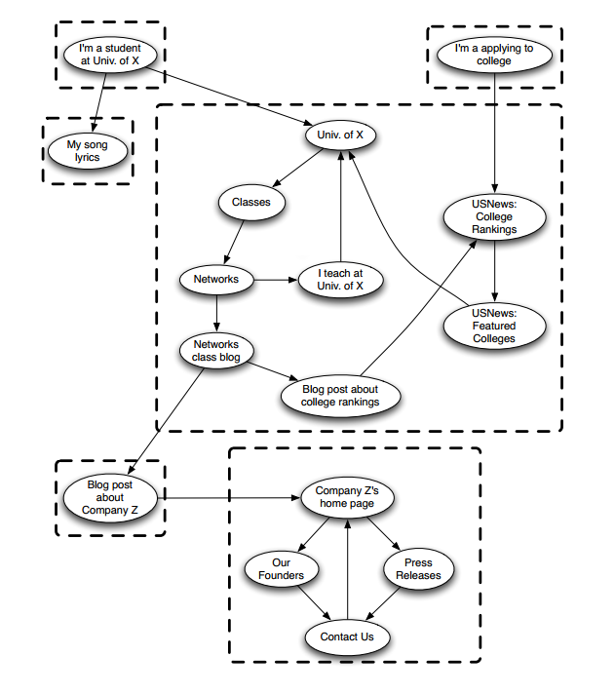
Different kinds of nodes
In the SCC
In the “inbound” part
In the “outbound” part
Tendrils
Disconnected nodes

Slide 31
Limitations
The bow-tie structure is a “mile high” view
Not understanding the role of specific nodes (sites)

Slide 32
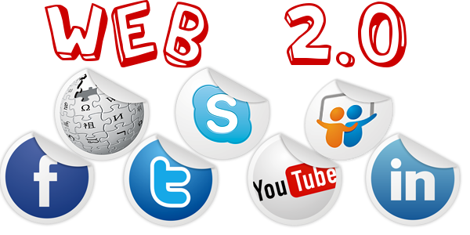
Web 2.0

Slide 33
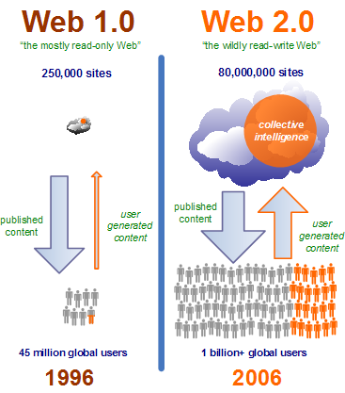
What is web 2.0?
A concept made popular by Tim O’railey in 2004
Basically – the web’s move towards a “Prosumer” crowd
Three main charachteristics:
(i) the growth of Web authoring styles that enabled many people to collectively create and maintain shared content;
(ii) the movement of people’s personal on-line data (including e-mail, calendars, photos, and videos) from their own computers to services offered and hosted by large companies;
(iii) the growth of linking styles that emphasize on-line connections between people, not just between documents.

Slide 34
Different implications of web 2.0
“Software that gets better as more people use it”
“The wisdom of the crowds”
“The Long Tail”

Slide 35
A little bit more a bout the structure of the web
From: Albert R., Jeong H, & Barabasi A. - Diameter of the World Wide Web (2000)

Slide 36
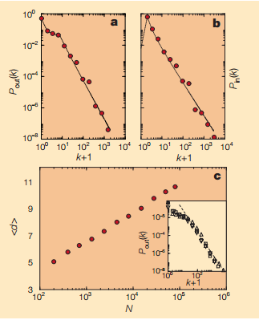
About the research
Trying to map reachability on the web
Their main finding – the probability of a node to have k links (inbound and out) follow a power law
Meaning – the web is a Small World Graph, typically found in biological and social networks
This was proven more by the short path research

Slide 37
